Slide 1

“Management, Information services and provision of Navigational Safety in the Maritime Spaces and Ports of Bulgaria –
Systems, Innovation and Future”
BPI Co.
Capt. Milen Todorov Ph.D.
Director SDD VTS Authority – Black Sea
Bulgarian Ports Infrastructure Co.
Varna, 17.09.2019

Slide 2
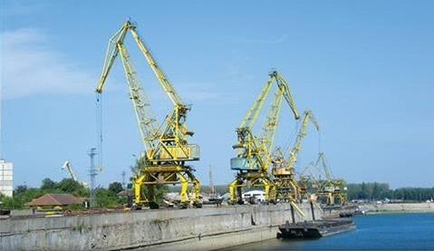
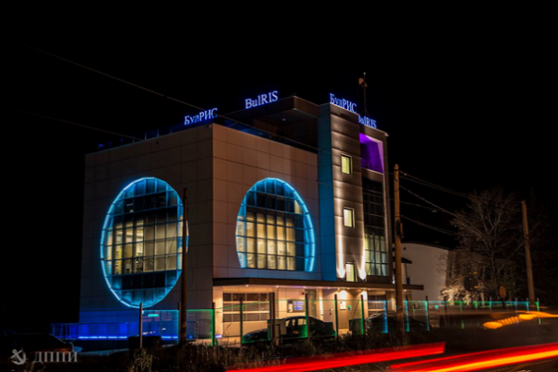
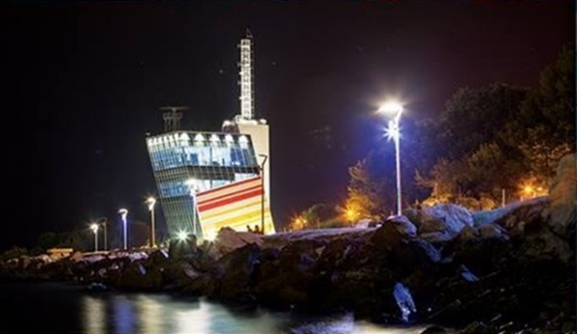
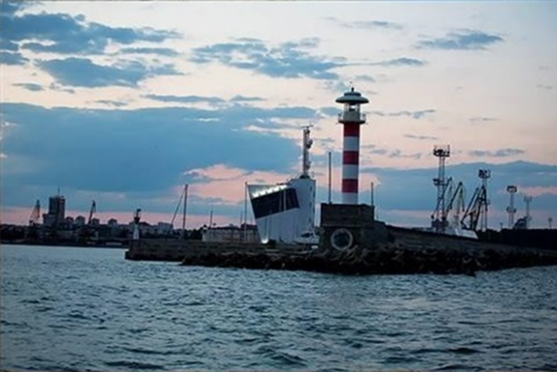
The Company
WE ARE
BPI Co.
Bulgarian Ports Infrastructure Company (BPI Co.) manages the port infrastructure of the public transport ports of national importance and provides traffic management and shipping information services.
Object of activity and status of BPI Co. are regulated by the Law on Maritime Spaces, Inland Waterways and Ports of the Republic of Bulgaria.
BPI Co. has four territorial directorates in Burgas, Varna, Lom and Ruse and three specialized divisions in Varna and Ruse.
SDD Vessel Traffic Services Authority – Black Sea provides the vessel traffic management and information services to shipping in the maritime spaces of Republic of Bulgaria.

Slide 3
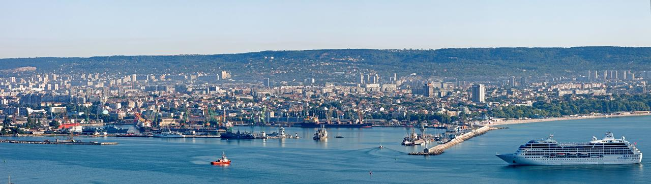
Vessel Traffic Services Authority – Black Sea Directorate – composition and personnel
WE ARE
BPI Co.
1. Operational services 24/7 – 45 persons:
Vessel Traffic Services Varna – 11 persons
Vessel Traffic Services Burgas – 11 persons
Coastal radio station Varna Radio – 11 persons
Information centers for electronic documentation in Burgas and Varna – 12 persons
2. Technical team – 20 persons
3. Administrative and support team – 15 persons

Slide 4
Services provided
BPI Co.
WE ARE
Monitoring and Management of ship traffic and navigational decision support;
Collecting, storing and providing information (navigational, meteorological, etc.);
Provision of Bulgarian part of the GMDSS and dissemination of maritime weather forecasts and maritime safety information;
Digitalization of the B2G dialogue by provision of digital information systems;
Provision of data exchange with European systems for maritime safety and security.
Year | Burgas | Varna
 | 2018 | 2018
Big vessels – international calls | 1612 | 1803
Big vessels – domestic calls | 213 | 96
Maneuvers of big vessels (over 300 GT) | 6743 | 6131
Small and domestic navigation vessels maneuvers | 2320 | 2252
Ship call procedures | Burgas | Varna
 | 2018 г. | 2018 г.
Opened procedures | 1631 | 1813
Ship calls | 1612 | 1803
Sailing permissions issued | 1418 | 1717
Domestic navigation procedures | 213 | 96

Slide 5
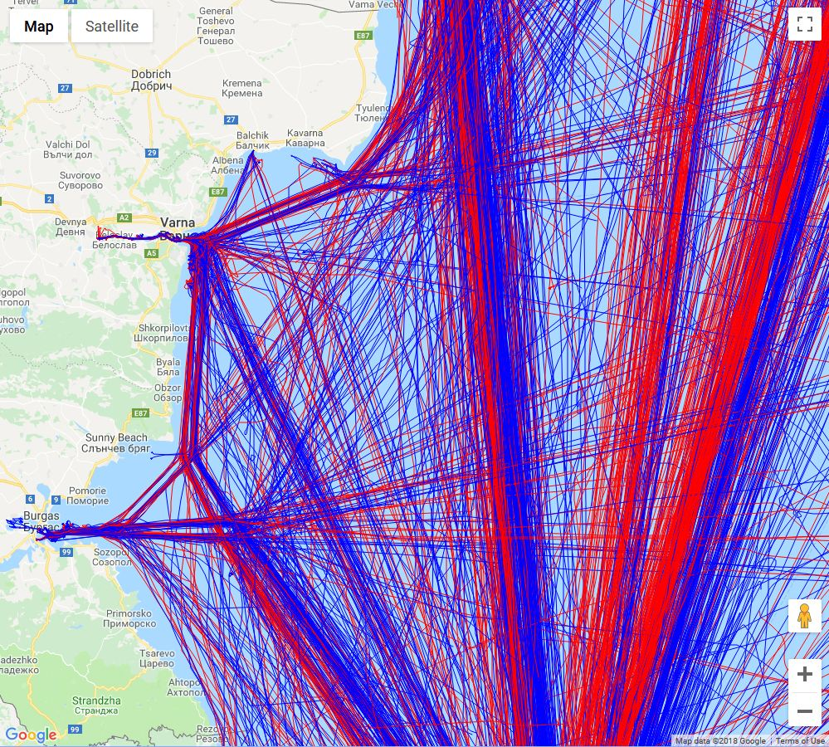
Improved safety and security of merchant shipping
GOALS
BPI Co.
Development of an integrated system for vessel traffic monitoring and management
Vessel traffic monitoring and organization,
Ship to shore communication and information services,
GMDSS and weather and safety information dissemination,
Enhansed monitoring of potentially dangerous for the environment vessels,
Establishment of coastal centers in burgas and varna, consisting of:
Operational centers for traffic management
Operational center of the Bulgarian part of the Global Maritime Distress and Safety System
Situational centers for coordination of incidents and emergency situations related to maritime activity
Continuous expanding the scope and functionalities of the existing systems in means of:
Vessel traffic management /VTS/ capabilities,
Technological modernization of the radio communication global maritime distress and safety system (GMDSS)
Safety
Environmental protection
Security
Efficiency

Slide 6
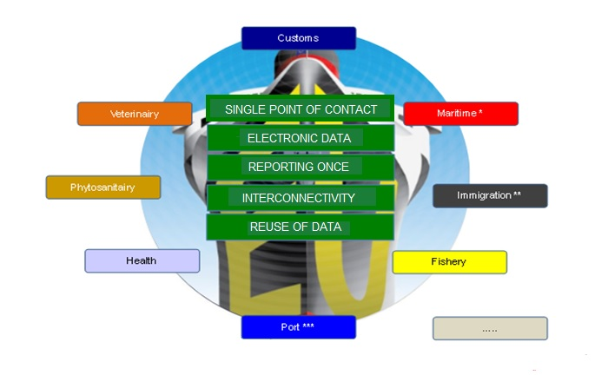
BPI Co.
GOALS
Improved port efficiency via digitalization and electronic governance
Digitalization of vessel traffic information and system-to-system exchange – automatic AIS and target data services to national and European systems;
Digitalization of mandatory vessel documentation in Bulgarian ports – “Maritime Single Window” for electronic processing of vessel documents;
Digitalization of port movements and vessel maneuvers planning – developed a Port Management System in 2015;
Digitalization of port activities, logistic and multimodal transport information exchange – conducted a feasibility study for PCS, finished in 2018, building and deployment is forthcoming;
Safety
Environmental protection
Security
Efficiency
Notes:
VTMIS - Directive 2009/17/EC, amending Directive 2002/59/EC - AIS data, ships digital database, automatic data exchange with SSN 2002 – Phase 1, 2007 – Phase 2, 2015 – Phase 3, Phase 4 – undergoing. In December 2015 within Phase 3 an automatic transfer of data with SSN was established. BULRIS – stage 1 – 2007 to 2013, stage 2 – 2013 to 2015;
MSW - Recommendation No. 33/2005, Directive 2010/65/EU – 2009 developing and deploying in 2009 a "Center of informational services to maritime transport - Varna and Burgas.“ and Maritime Single Window for digital documentation of vessel calls in May 2015, Single Window River completed in 2017;
PMS – Developing and deploying a Port Management System “MOVER” in 2015;
PCS - Conducted a feasibility study for PCS, finished in 2018, building and deployment is forthcoming

Slide 7
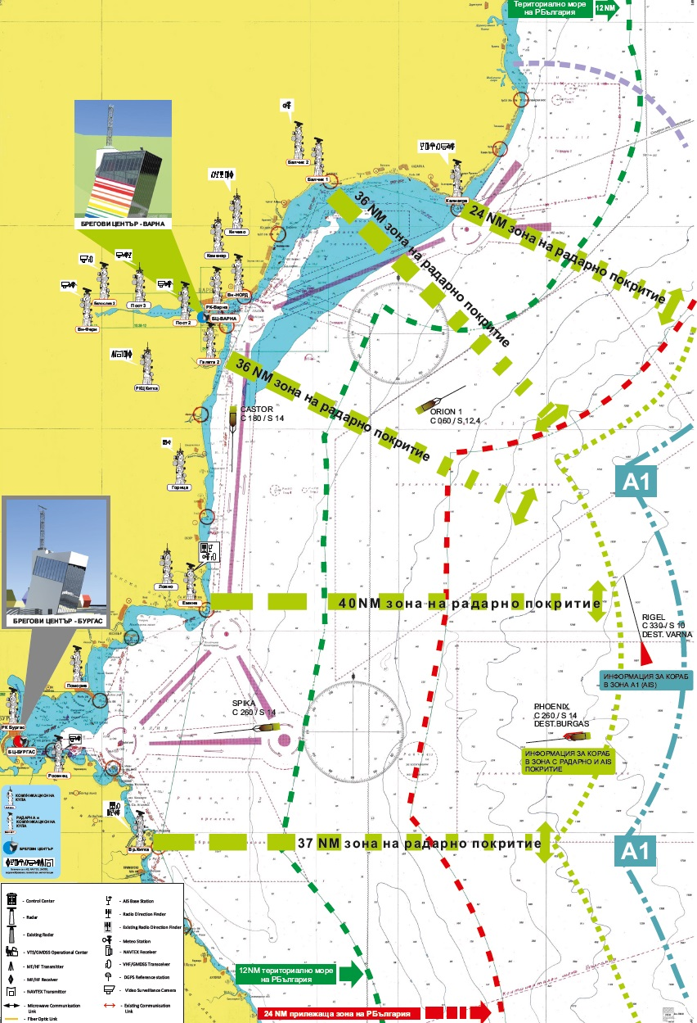
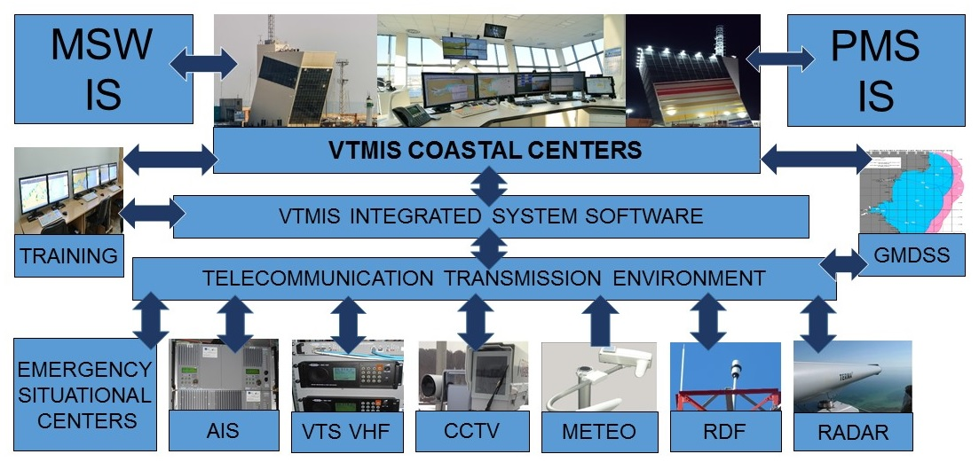
Integrated system for safety of navigation
BPI Co.
DEVELOPMENT
MONITOR
ALERT
RESPOND
Collect and
process the data
Create common operational picture
Distribute data to clients
Analyze traffic
Detect dangerous
traffic situations
Increase situation awareness
Provide decision
support services
Ensure ship
to shore communications
Notes:
Digitalization of vessel data by AIS and VTMIS system softuare;
Digitalization of vessel traffic (safety and environmental) data;
Establishing an automatic exchange with other systems (e.g. SSN).

Slide 8
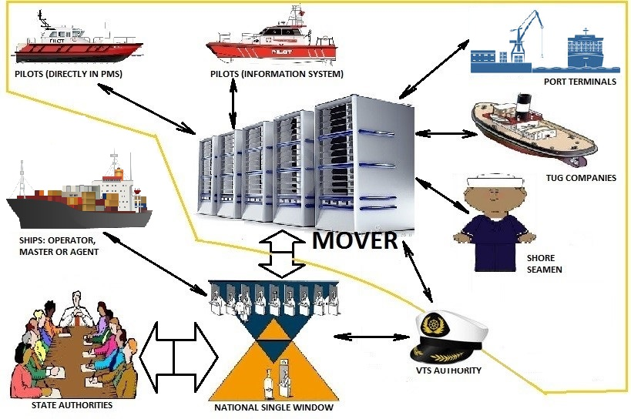
Improved port safety and efficiency via digitalization of inner navigation planning
BPI Co.
DEVELOPMENT
Port Management System (PMS)
Improved cooperation among participants in port movements and navigational operations;
Improved safety of navigation in ports;
Facilitation of port navigational operations;
Reduced time of mooring/unmooring activities.
Vessel
NSW
Ship Agent
Data exchanged
planned time of movement and required place in port;
status of readiness of port terminals;
disposition of tugs, pilot boats and other support craft;
availability of pilots and mooring men;
necessary number of tugs and meteorological limitation for every particular vessel and port area;
Times of berthing/unberthing for port taxes calculation;
Administration special permissions, etc.
Port terminal
Governmental Bodies
MOVER
Tug Company
Pilot Station
Shore Seamen
VTS
OTHER SYSTEMS
NSW
SSN

Slide 9
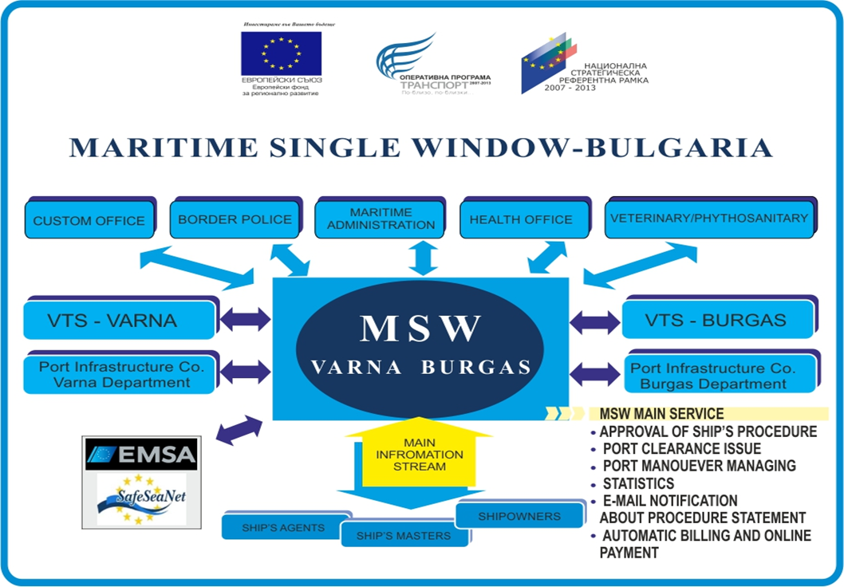
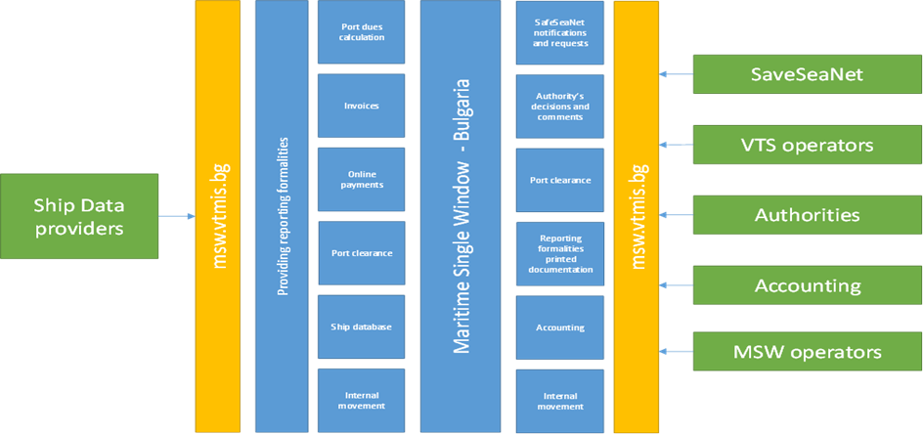
Improved port efficiency via digitalization of the mandatory ship documentation – MSW
BPI Co.
DEVELOPMENT
Maritime Single Window (MSW)
A Requirement of European Directive 2010/65;
Electronic B2G dialogue and governance;
Improved cooperation between maritime and customs authorities;
Facilitation of documentation work in the ports;
Reduced time for ship’s formalities processing.
Data exchanged:
Reporting formalities resulting from legal acts of the Union
FAL forms and formalities resulting from international legal instruments
Any relevant national legislation
Notes:
Main principals:
Single point of contact;
Electronic machine-processed data;
Reporting once;
Reuse of data;
Interconnectivity.

Slide 10
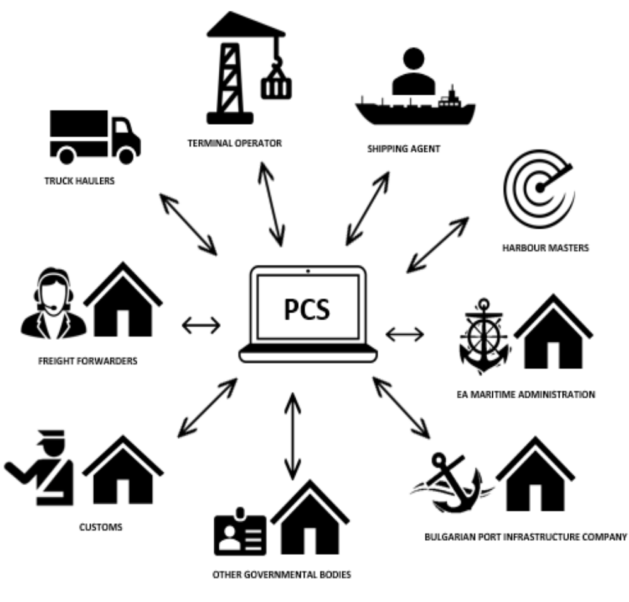
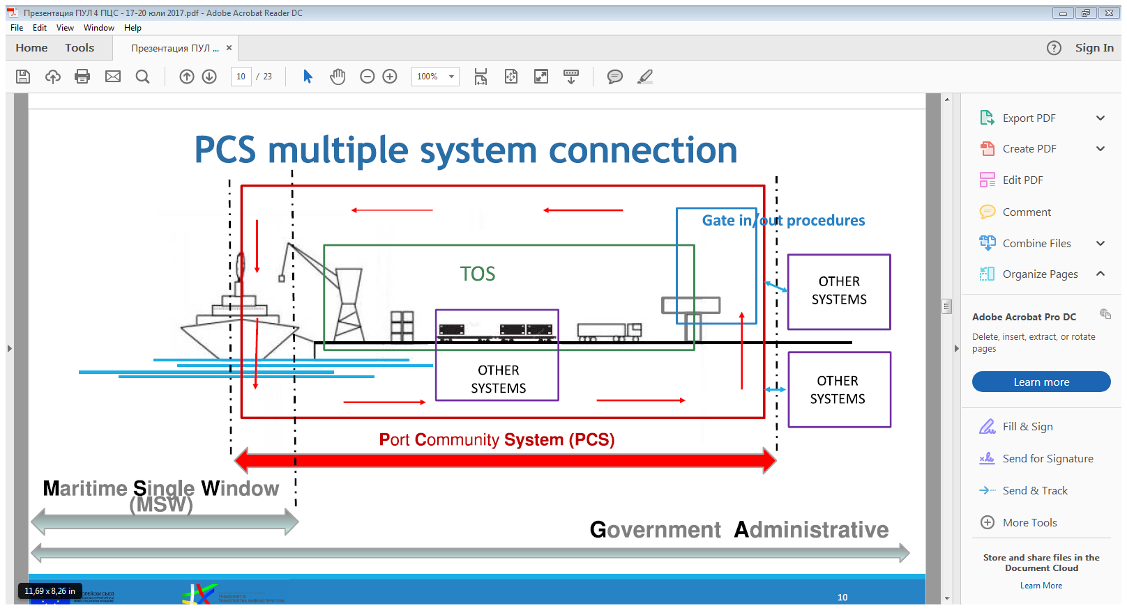
Improved port efficiency via digitalization of the information flow in the logistic chains
BPI Co.
DEVELOPMENT
A completed feasibility study and an ongoing development project for implementation of digital information system of the port community (PCS)
Notes:
Players in PCS – scope of the port community:
AGENTS AND/OR SHIPPING COMPANIES;
BPI Co;
MARAD;
Customs;
Border police;
Other governmental bodies;
FREIGHT FORWARDER;
TERMINAL OPERATORS;
RAIL CARRIERS;
ROAD HAULERS etc.

Slide 11
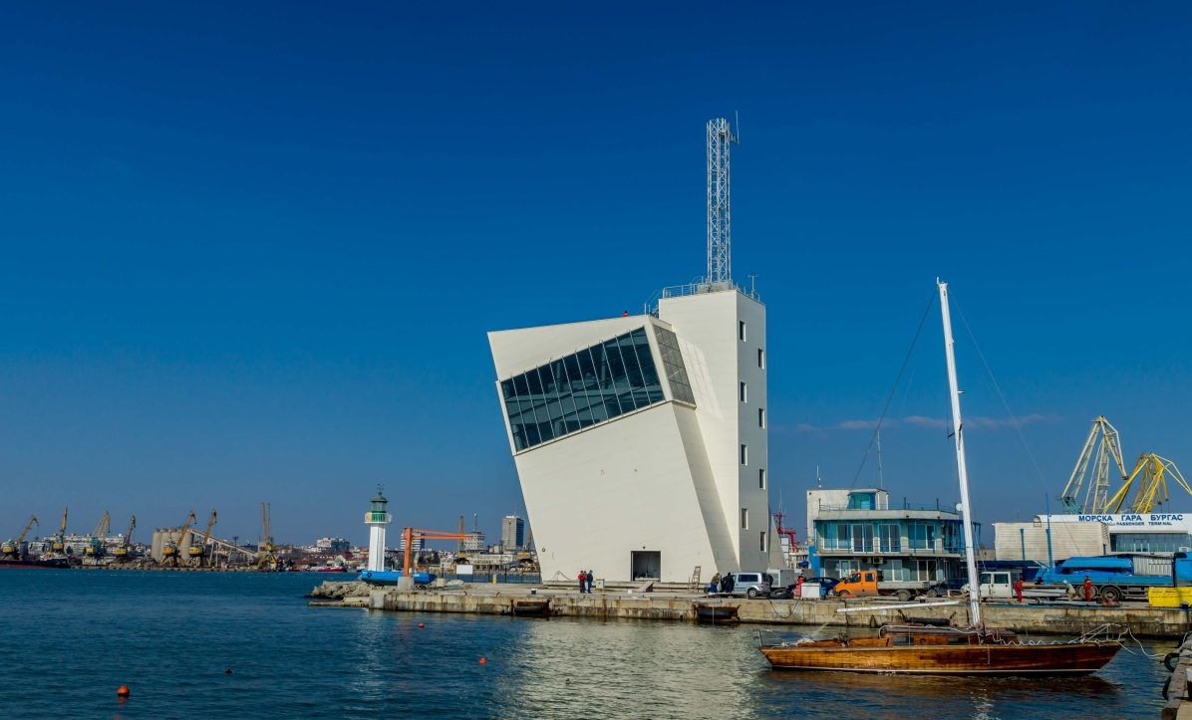
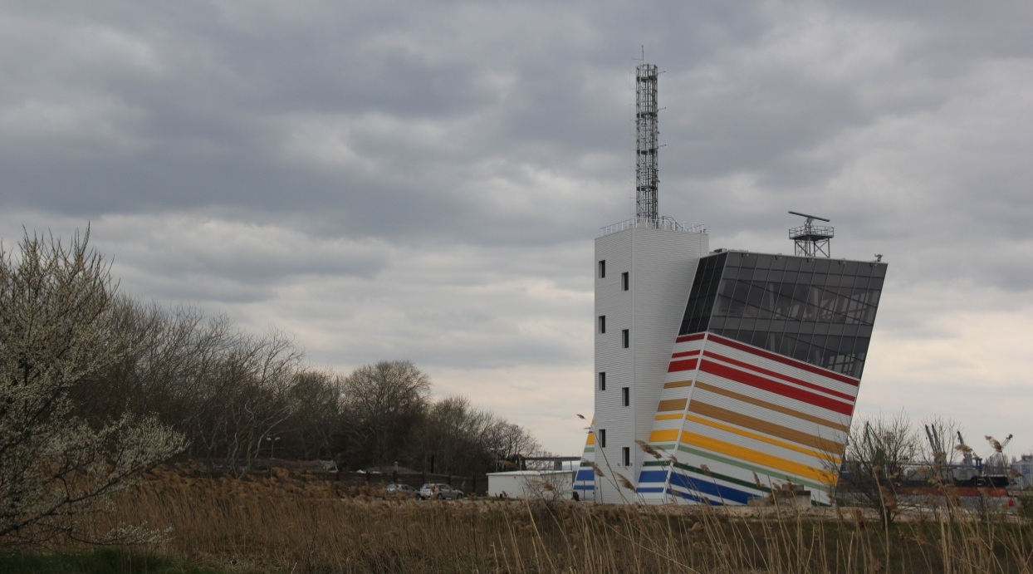
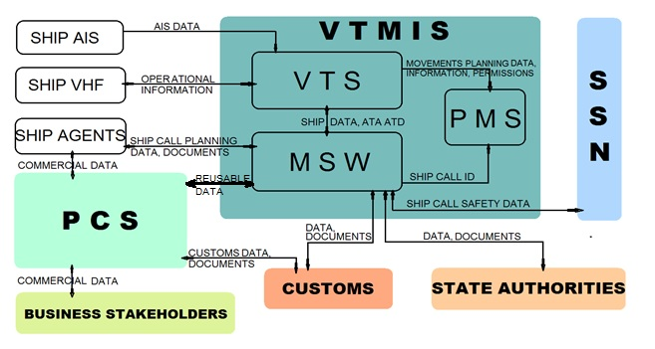
Integrated Information Environment in Bulgarian Ports
BPI Co.
DEVELOPMENT
Build up one of the most up-to-date vessel traffic management and information system – a base for integrated port electronic information environment
Introduced e-governance in maritime and inland waterway transport – Single Window systems on the sea and river, Port Management System in the sea ports and developing a Port Community System.

Slide 12
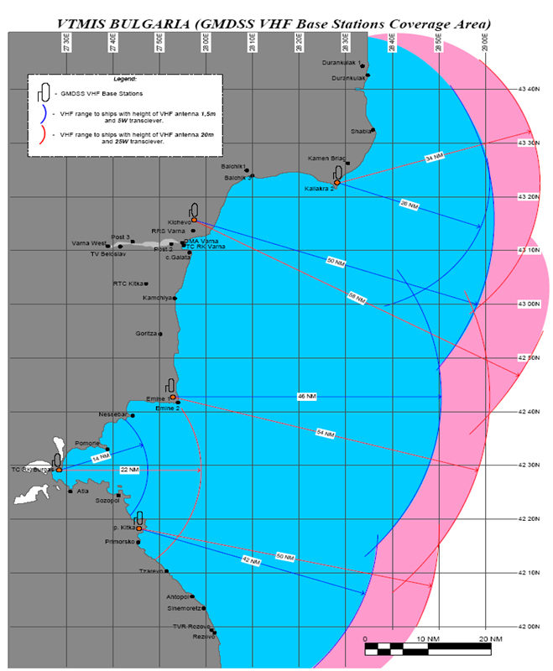
Bulgarian part of the GMDSS, provided by Varna-radio
BPI Co.
DEVELOPMENT
Technical system (hardware and software) provides coverage of GMDSS areas A1, A2, and broadcast information about the safety of shipping by the means of the NAVTEX system
GMDSS operating center uses all remote radio resources (base stations, transmission and receiving center)
All communications of the maritime rescue coordination center (MRCC) are being provided by the GMDSS

Slide 13
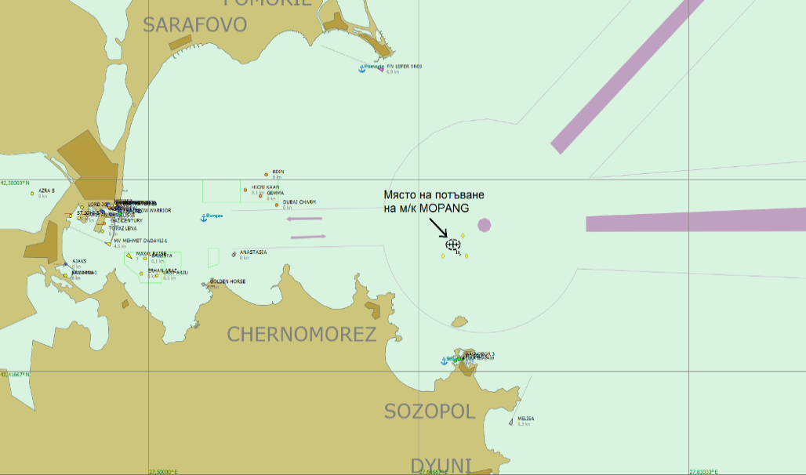
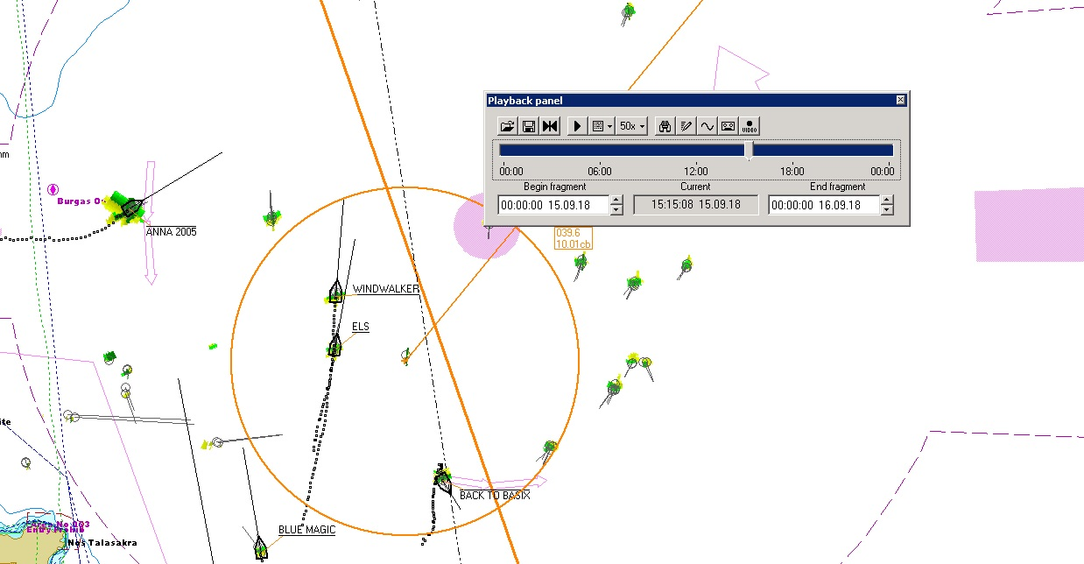
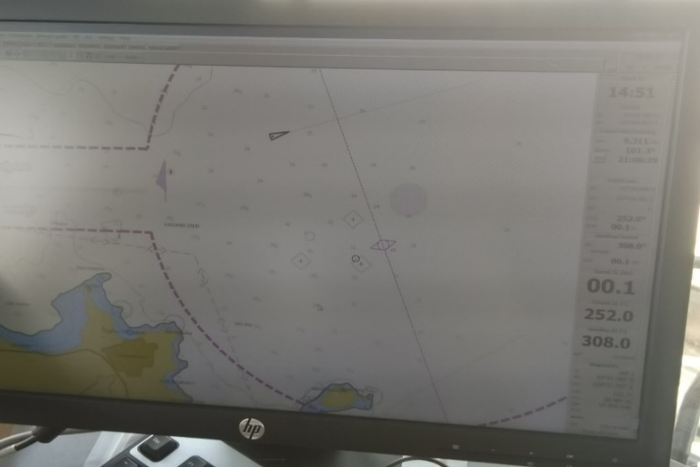
Virtual Aids to Navigation
BPI Co.
INNOVATION
Use of AIS capabilities to broadcast virtual and synthetic AtoN
Visualization of AtoN information for new or temporary objects and dangers to navigation directly on the displays of the ship’s navigation systems (ECDIS)
S1ignificantly improved awareness of the navigational watch
An example of a practical result of using such a system is the “Mopang” fuel drain operation in the TSS in the approaches of port Burgas:
A vessel sank on 30.06.1921. and started leaking fuel oil in the summer of 2018 in an area of heavy ship traffic.
After broadcasting the virtual and synthetic AtoN the navigation situation has improved significantly

Slide 14
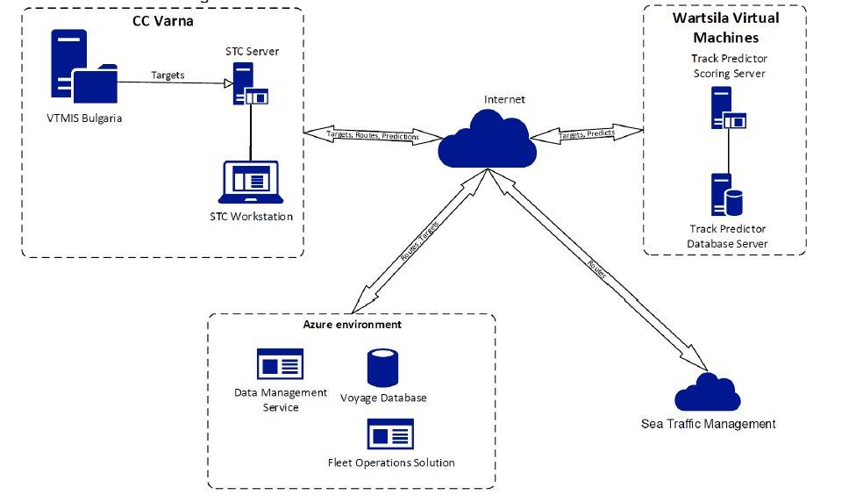
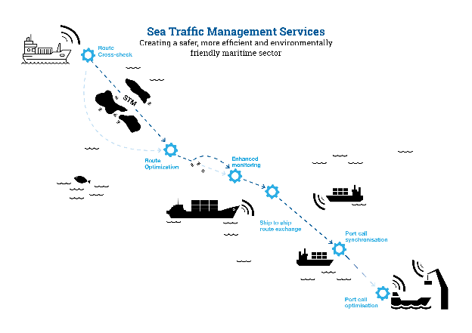
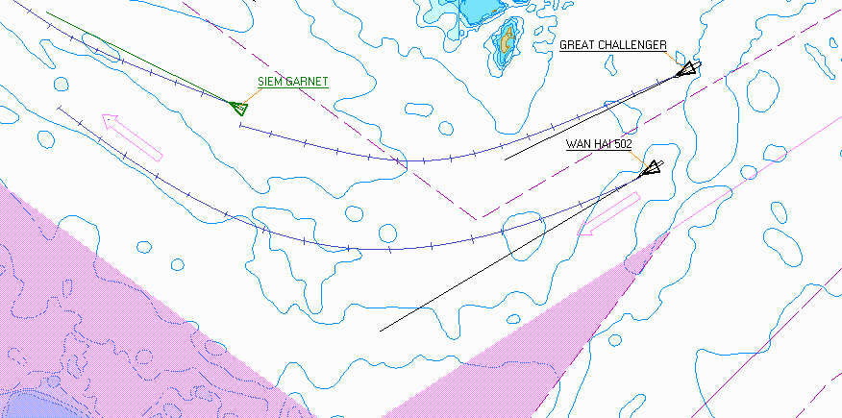
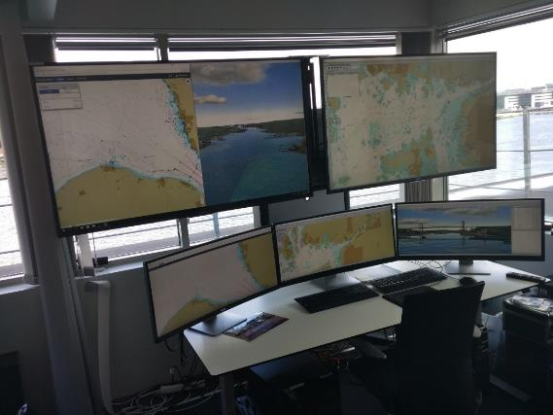
Artificial intelligence in navigation
BPI Co.
INNOVATION
Next VTS Generation
Berth-to-Berth Traffic Control
Long Range Monitoring
E-Navigation approach
Active decision support
Modern technologies
(i.e. machine learning, big data analytics)
STC SAFETY MODULE
Track Predictor
COLREG Warning
Active Decision Support
STC Operator approval
Delivery of recommendation to Vessel

Slide 15
Expected effects, result of the safety, environmental and electronic governance politics of BPI Co.
BPI Co.
WE AIM
Improved safety of navigation and improved protection of human life at sea;
Improved environmental protection;
Improved b2g dialogue for enhanced law enforcement and improved safety and security of the ports;
Improved efficiency and competitiveness of Bulgarian ports.

Slide 16
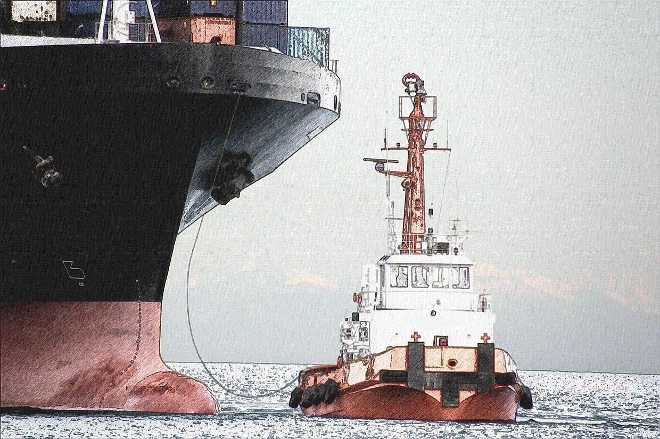
THANK YOU
FOR
YOUR
ATTENTION!

