Slide 1

“Aids to Navigation and Vessel Traffic Services in Bulgaria”
Capt. Milen Todorov Ph.D.
Director of VTS Authority
Bulgarian Ports Infrastructure Co.
IALA WAtoN Day – Burgas, July 1st 2022

Slide 2
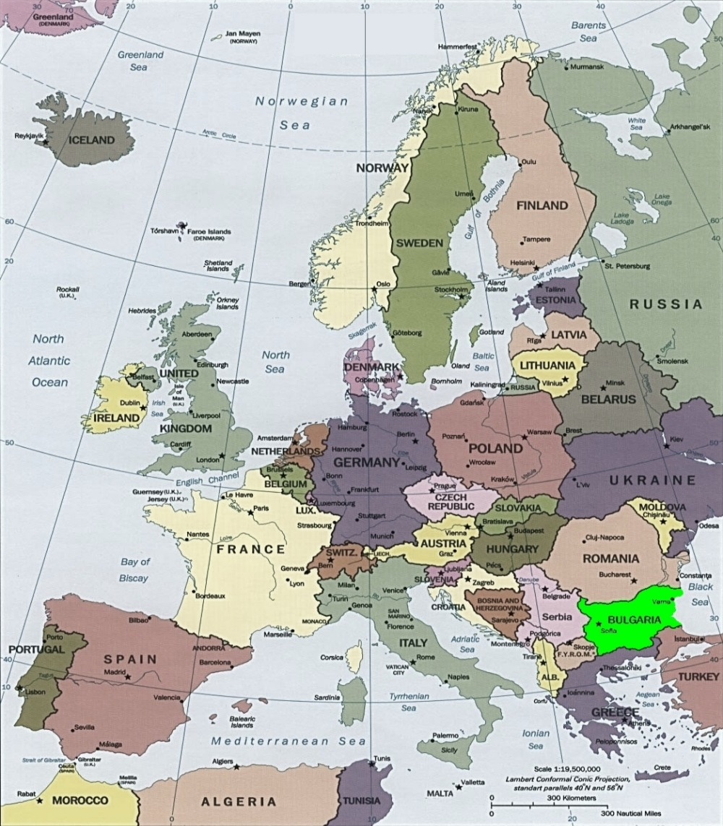
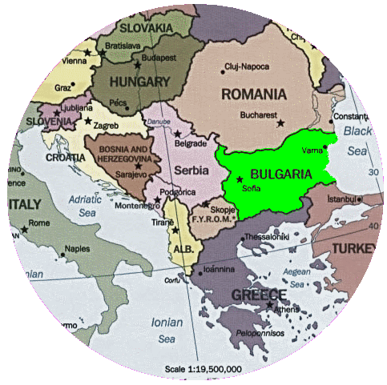
Geographical location of Bulgaria

Slide 3
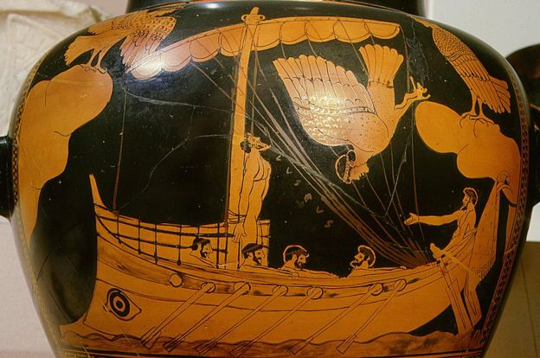
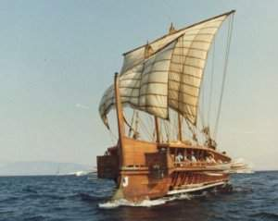
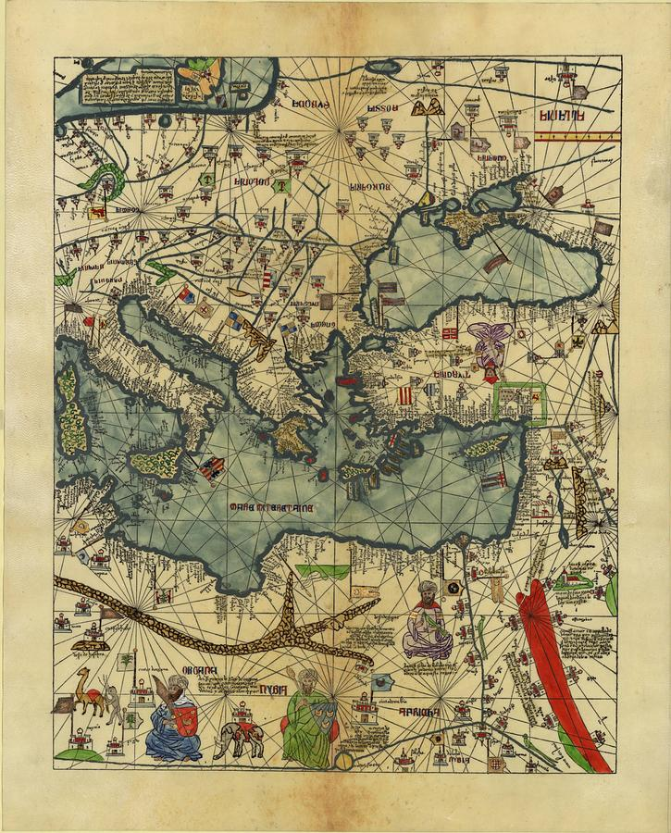
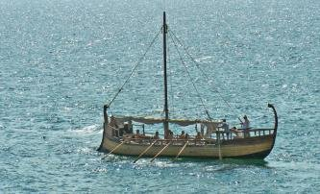
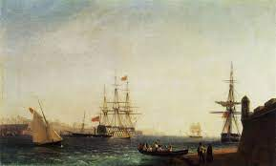
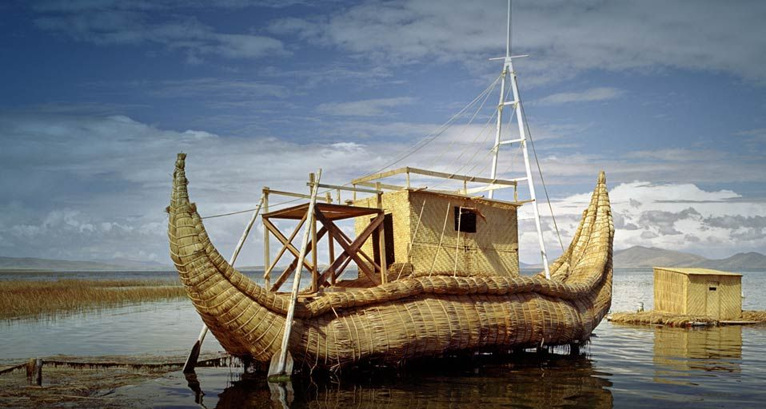
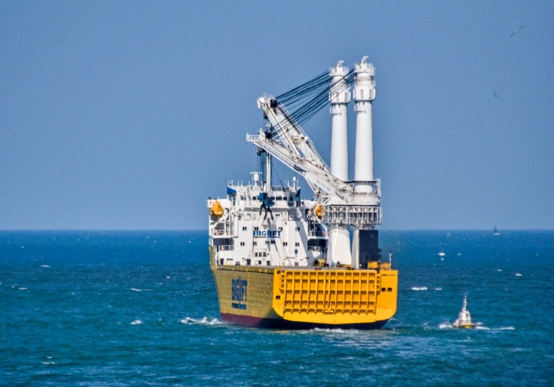
Ancient add modern routes

Slide 4




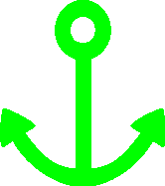
Bulgarian Black Sea and Danube River Ports
Danube River
Vidin
Oryahovo
Silistra
Somovit
Lom
Ruse
Svishtov
Balchik
Varna
Black Sea
Sofia
Nesebar
Burgas

Slide 5
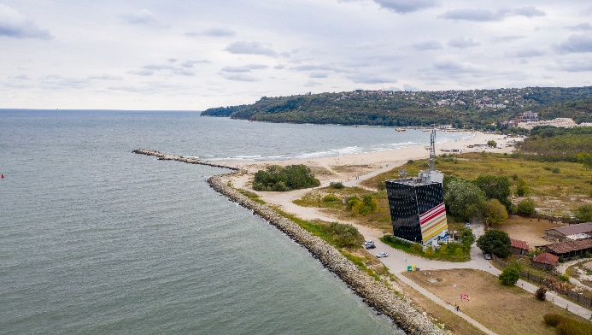
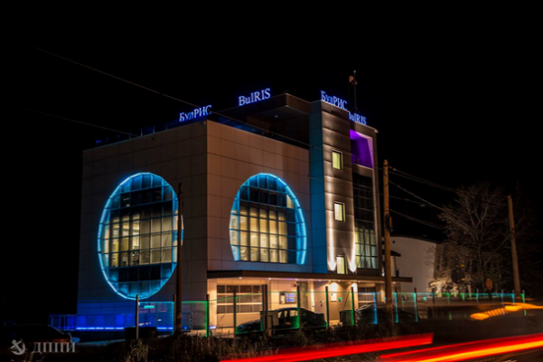
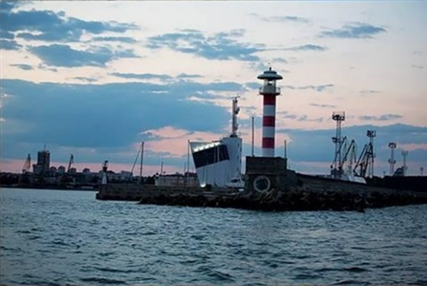
Bulgarian Ports Infrastructure Company
Bulgarian Ports Infrastructure Company is the managing body of the Bulgarian public transport ports and provides vessel traffic and shipping information services.
Some of the main activities of BPI Co.:
building ports and port terminals – property by the state, and reconstruction, rehabilitation, and maintenance of port terminals – property of the state, from the public transport ports;
maintaining the existing and building new approach canals, port water areas, breakwaters, protection facilities and facilities of the common technical infrastructure, including AtoN;
securing the navigation safety in the territorial sea, the internal sea waters, the canals and the port water area;
building, maintenance and administration of a national system for electronic exchange of information in the public transport ports.

Slide 6
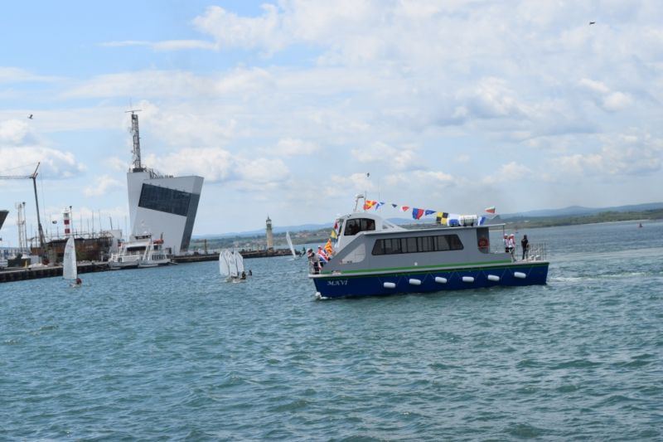
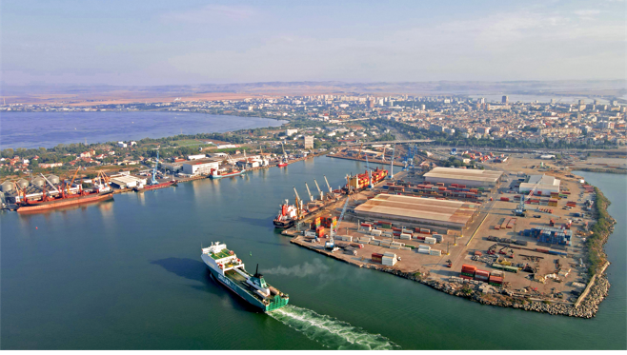
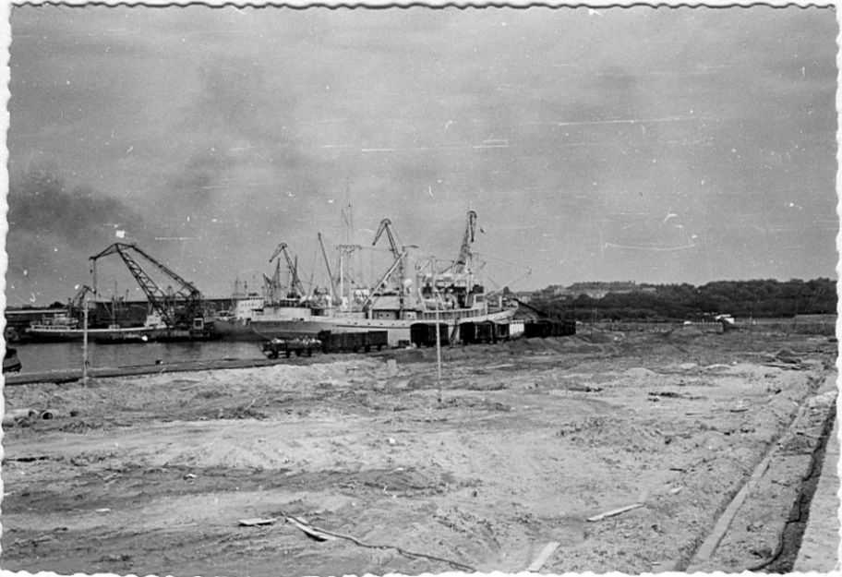
Port of Burgas

Slide 7
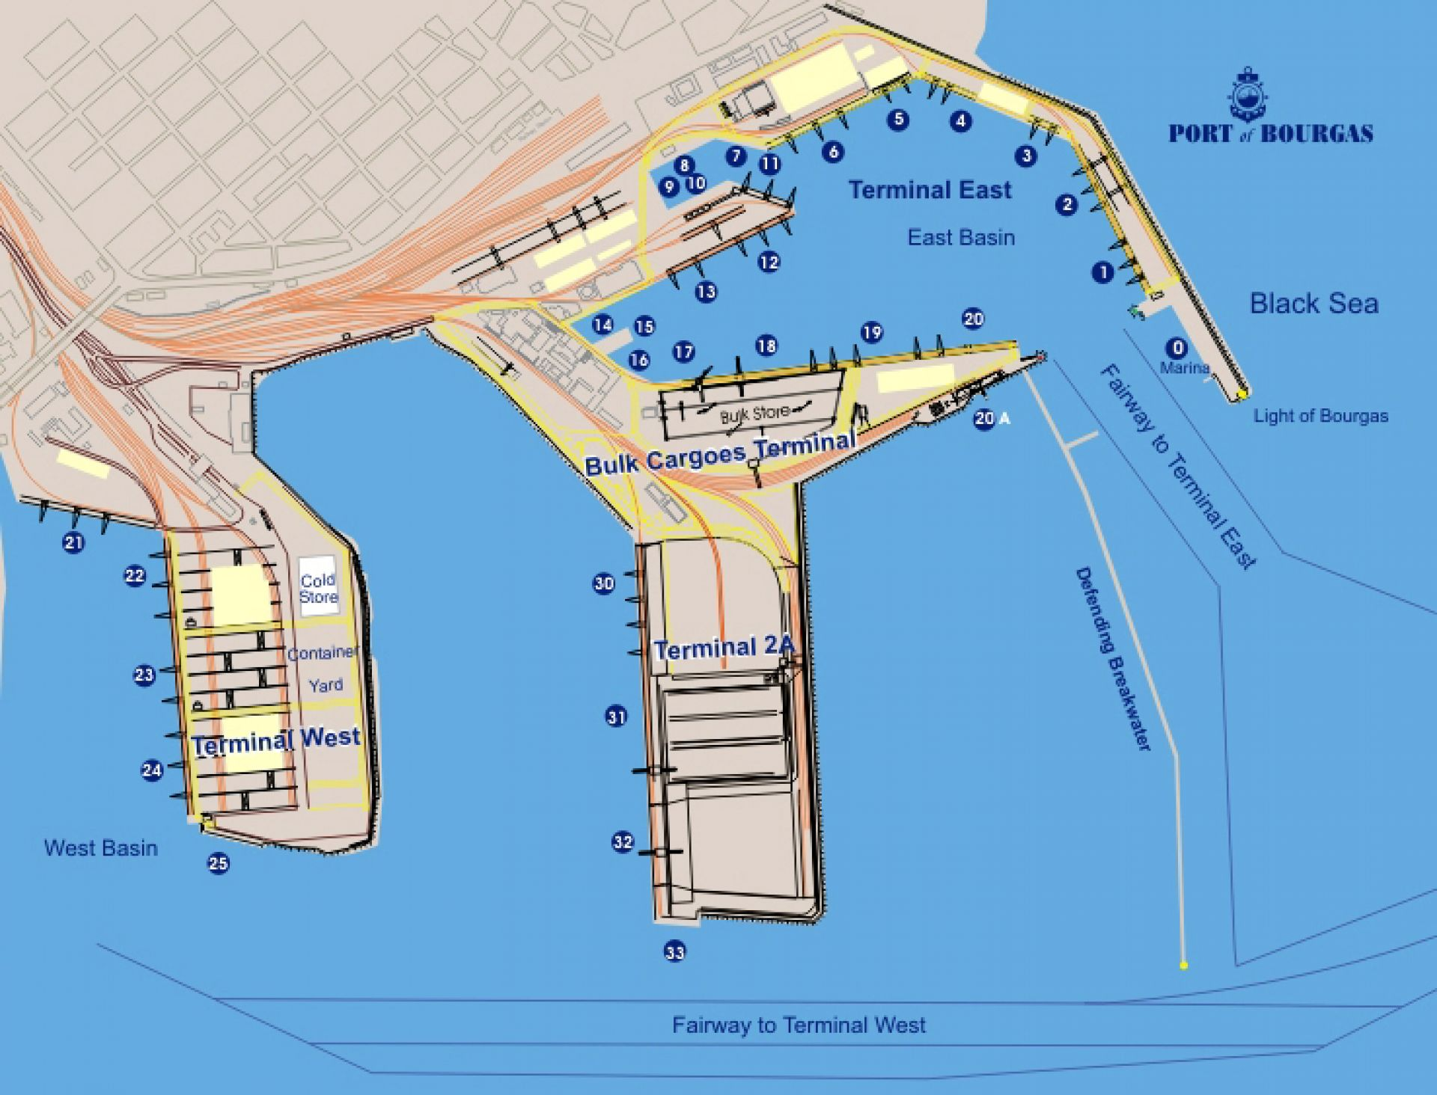
Port of Burgas Water Area

Slide 8
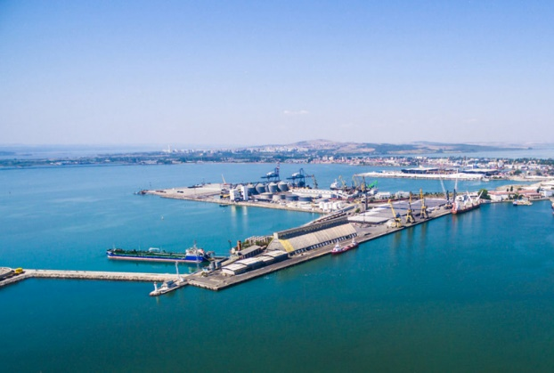
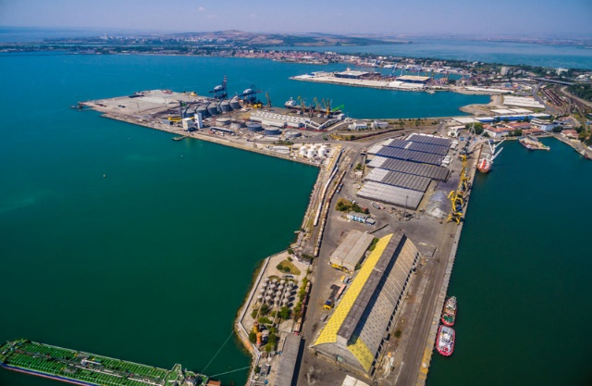
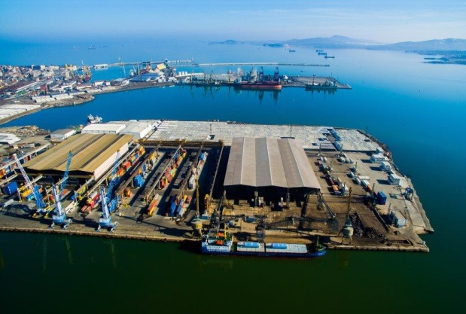
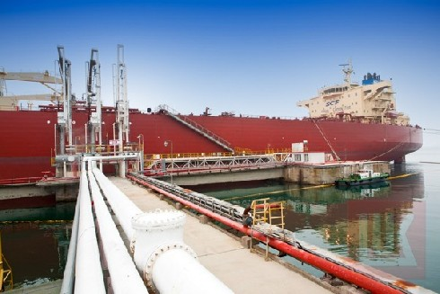
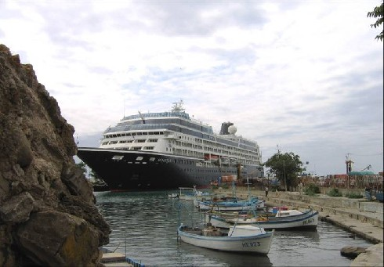
Port of Burgas Branch
Region of operation of Port of Burgas Branch is from the geographical parallel of Cape Emine to the geographical parallel of the Bulgarian-Turkish boarder, with Head office in Burgas.
Port Terminal Burgas East 1 Port Terminal Burgas East 2 Port Terminal Burgas West
Port Terminal Rosenets Port Terminal Nessebar

Slide 9
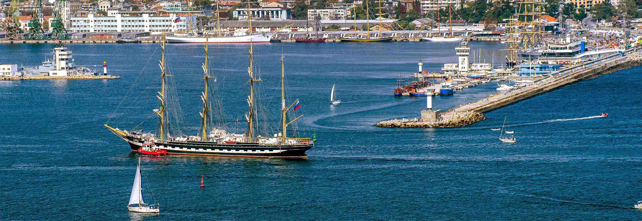
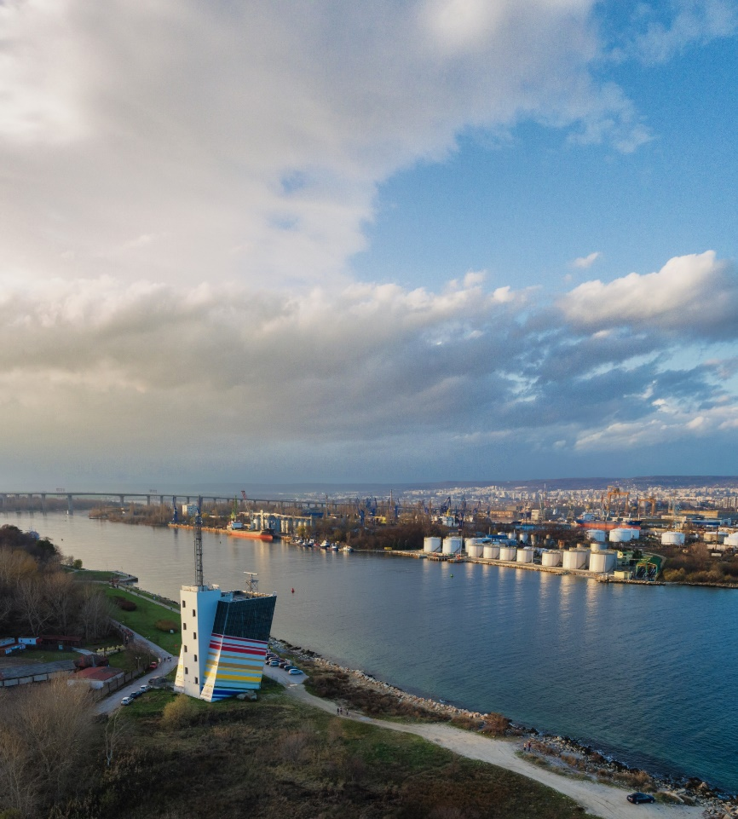
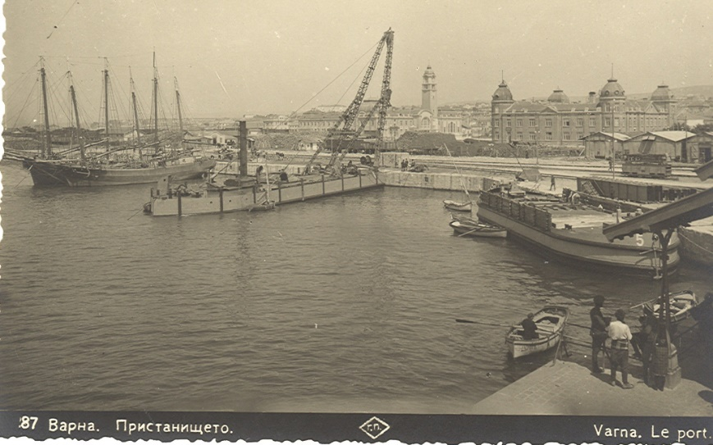
Port of Varna

Slide 10
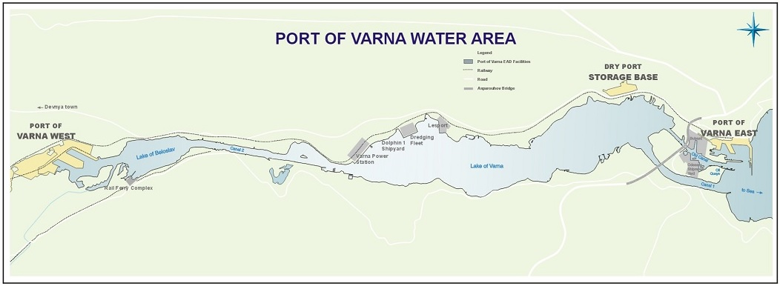
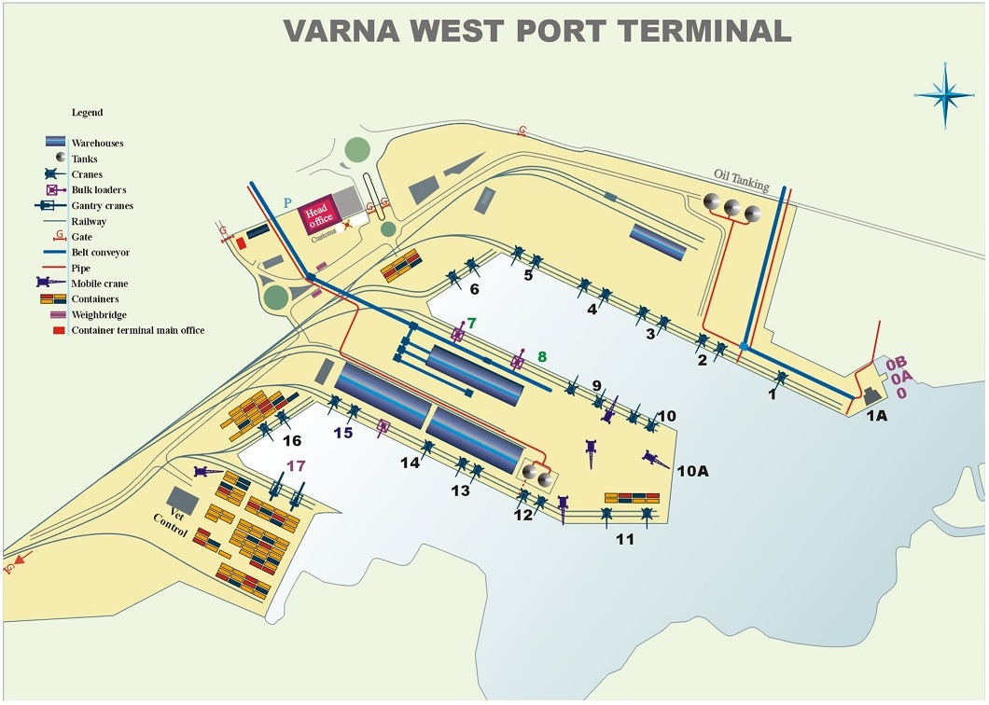
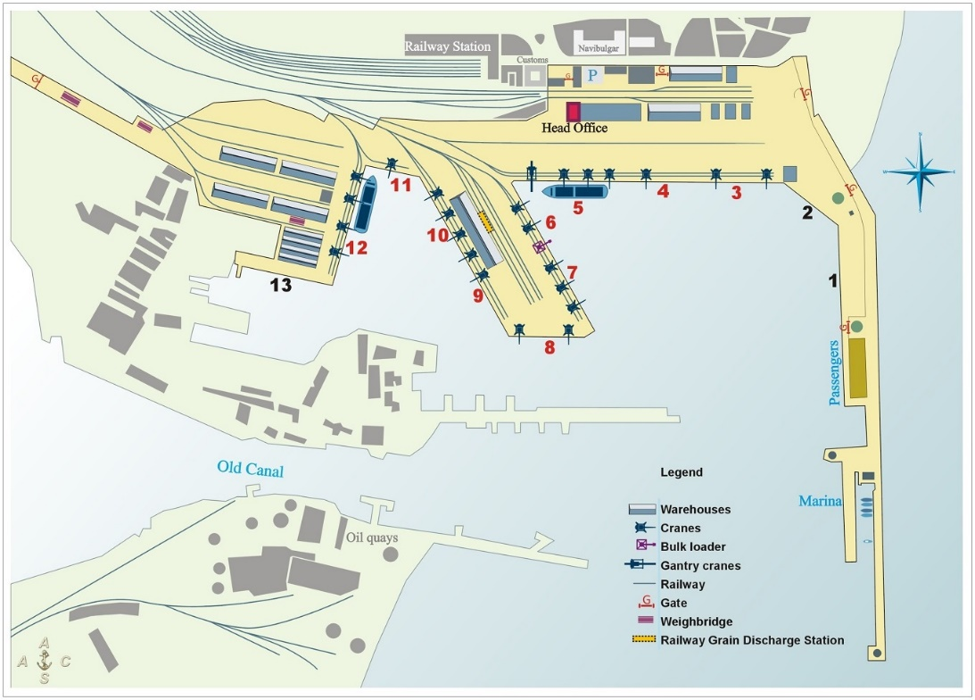
Port of Varna Water Area

Slide 11
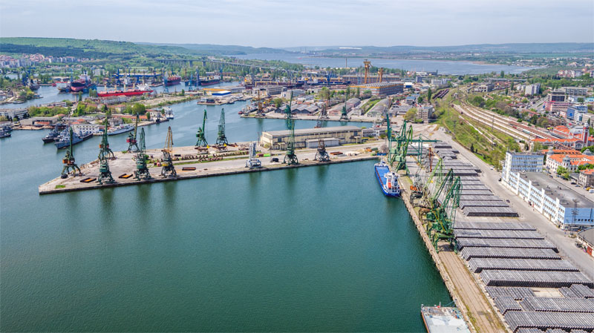
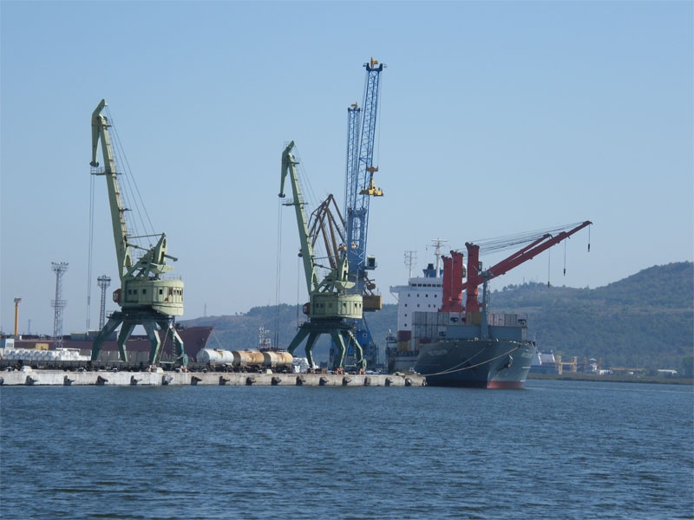
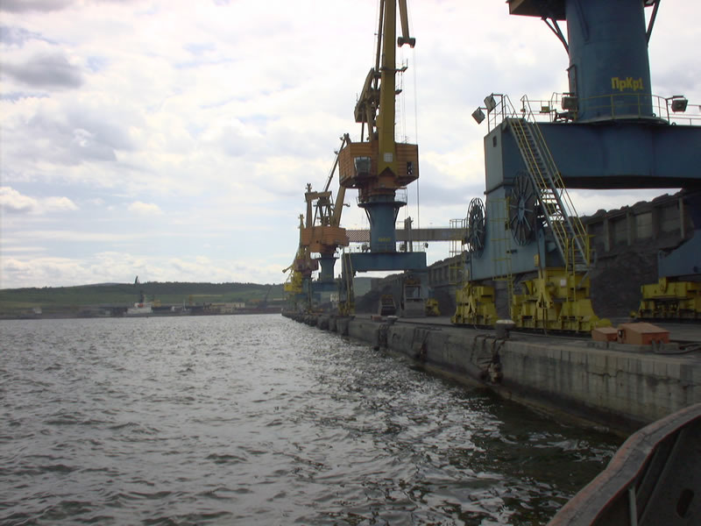
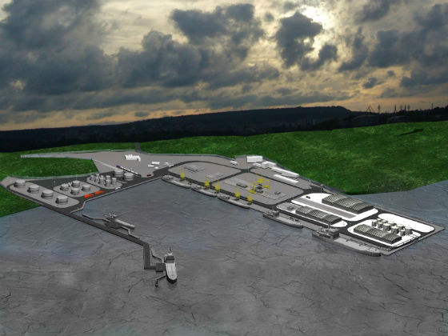

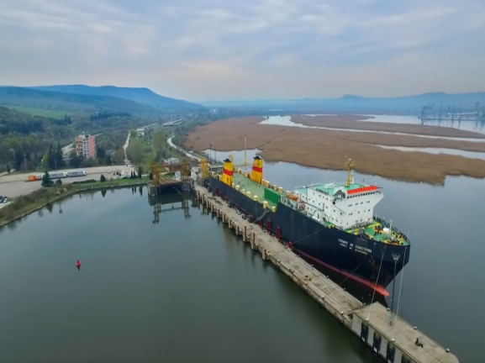
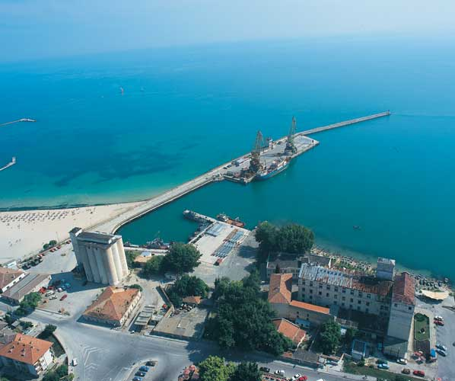
Port of Varna Branch
Region of operation of Port of Varna Branch is from the geographical parallel of the Bulgarian-Romanian border to the geographical parallel of Cape Emine, with Head office in Varna.
Port Terminal Varna East Port Terminal Varna West Port Terminal Petrol
Port Terminal Lesport Port Terminal TPP Ferry Complex Varna Port Terminal Balchik

Slide 12
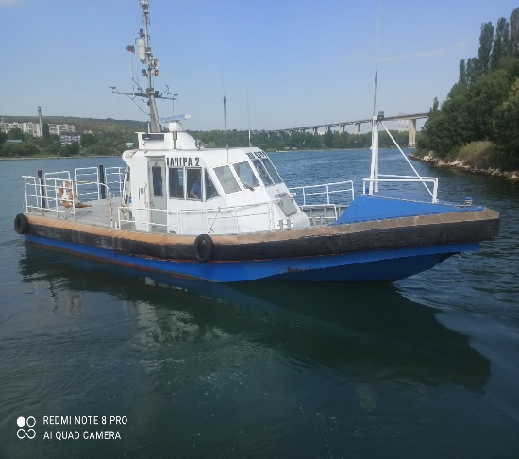
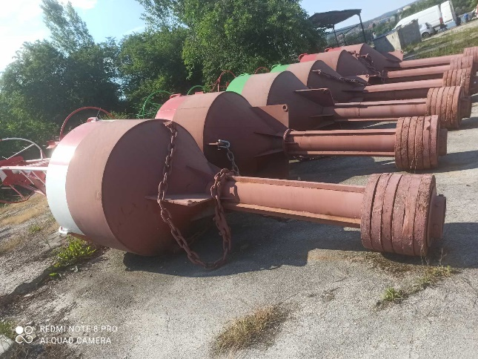
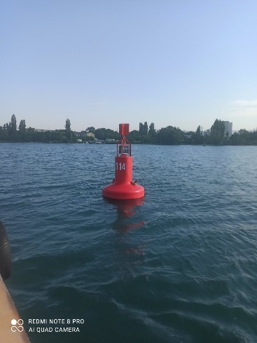
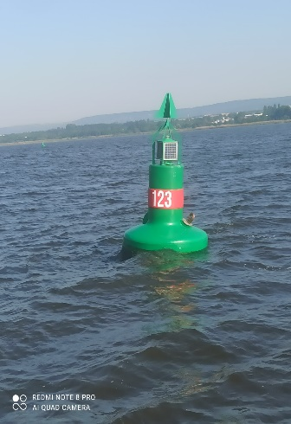
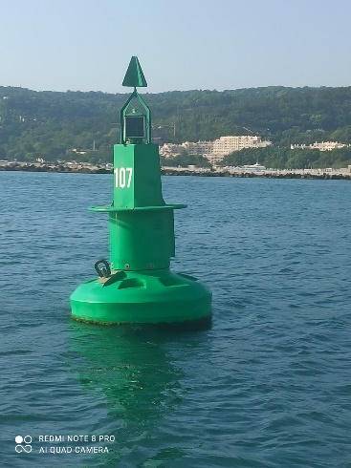
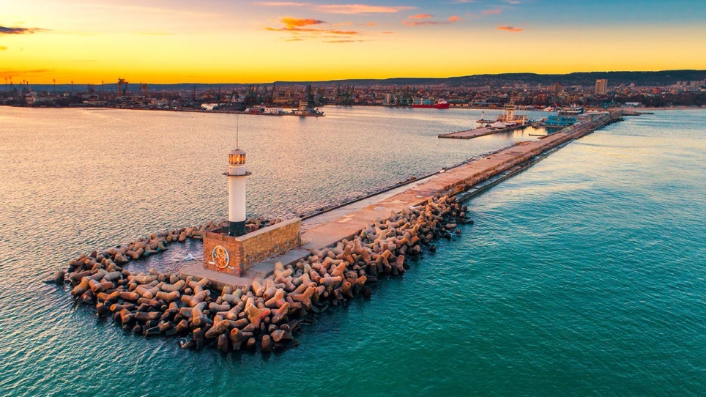
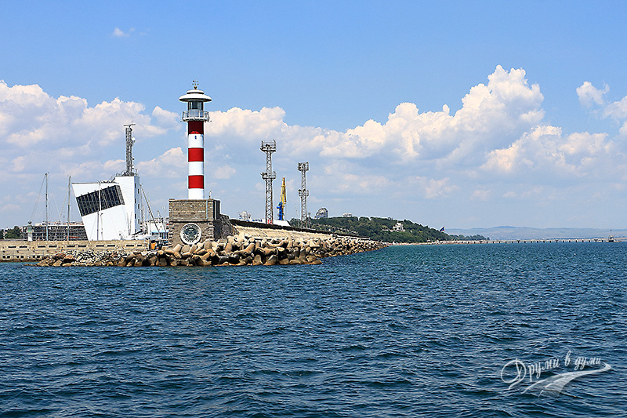
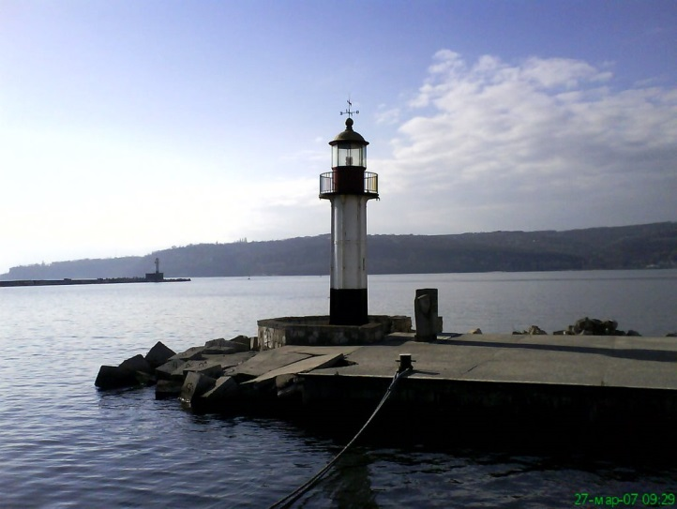
Aids to Navigation in Bulgarian Ports
IALA Buoyage System region A with lateral and cardinal marks in the approaches, channels and water areas of the ports
Lighthouse facilities in the approaches and port entrances

Slide 13
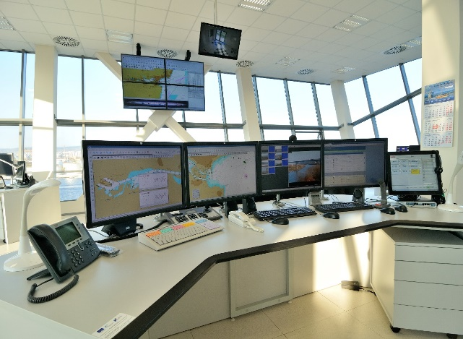
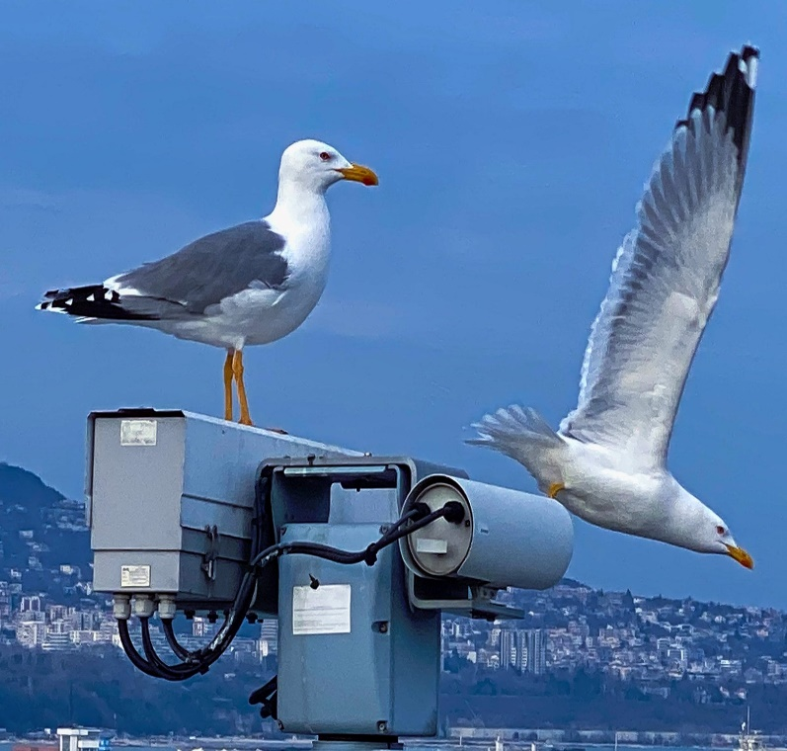
Vessel Traffic Services Authority
Monitoring and Management of ship traffic and navigational decision support;
Collecting, storing and providing information (navigational, meteorological, etc.);
Provision of Bulgarian part of the GMDSS and dissemination of maritime weather forecasts and maritime safety information;
Digitalization of the B2G dialogue by provision of digital information systems;
Provision of data exchange with European systems for maritime safety and security.

Slide 14
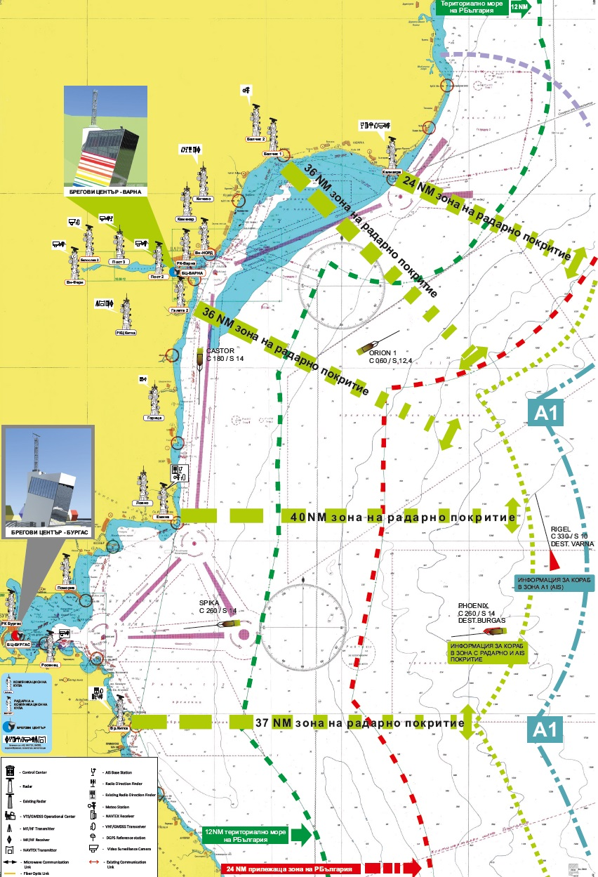
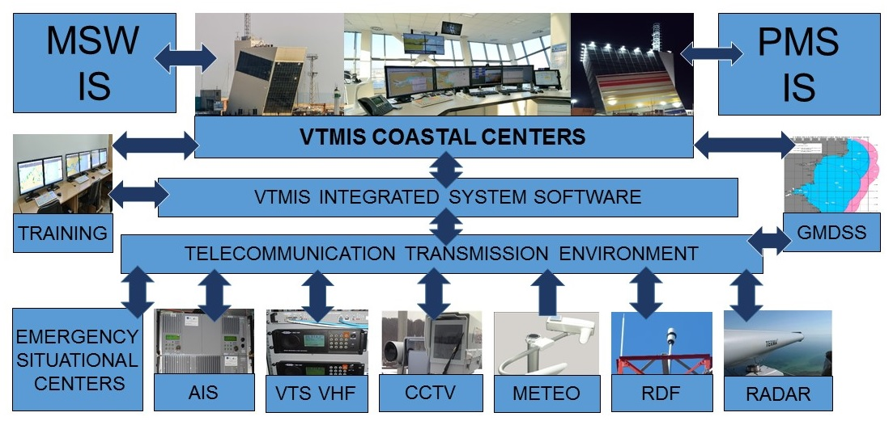
Integrated system for safety of navigation
MONITOR
ALERT
RESPOND
Collect and
process the data
Create common operational picture
Distribute data to clients
Analyze traffic
Detect dangerous
traffic situations
Increase situation awareness
Provide decision
support services
Ensure ship to shore communications
Notes:
Digitalization of vessel data by AIS and VTMIS system softuare;
Digitalization of vessel traffic (safety and environmental) data;
Establishing an automatic exchange with other systems (e.g. SSN).

Slide 15
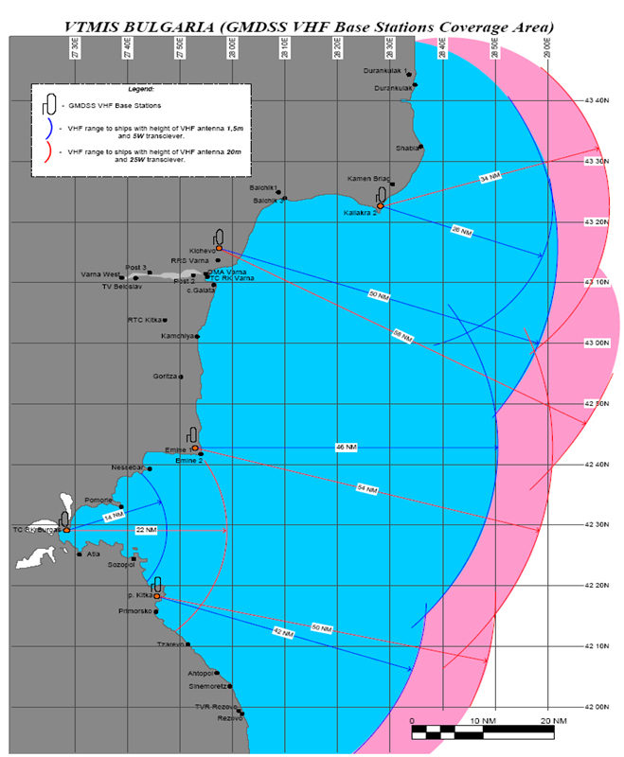
Bulgarian part of the GMDSS, provided by Varna Radio
Technical system (hardware and software) provides coverage of GMDSS areas A1, A2, and broadcast information about the safety of shipping by the means of the NAVTEX system
GMDSS operating center uses all remote radio resources (base stations, transmission and receiving center)
All communications of the maritime rescue coordination center (MRCC) are being provided by the GMDSS

Slide 16
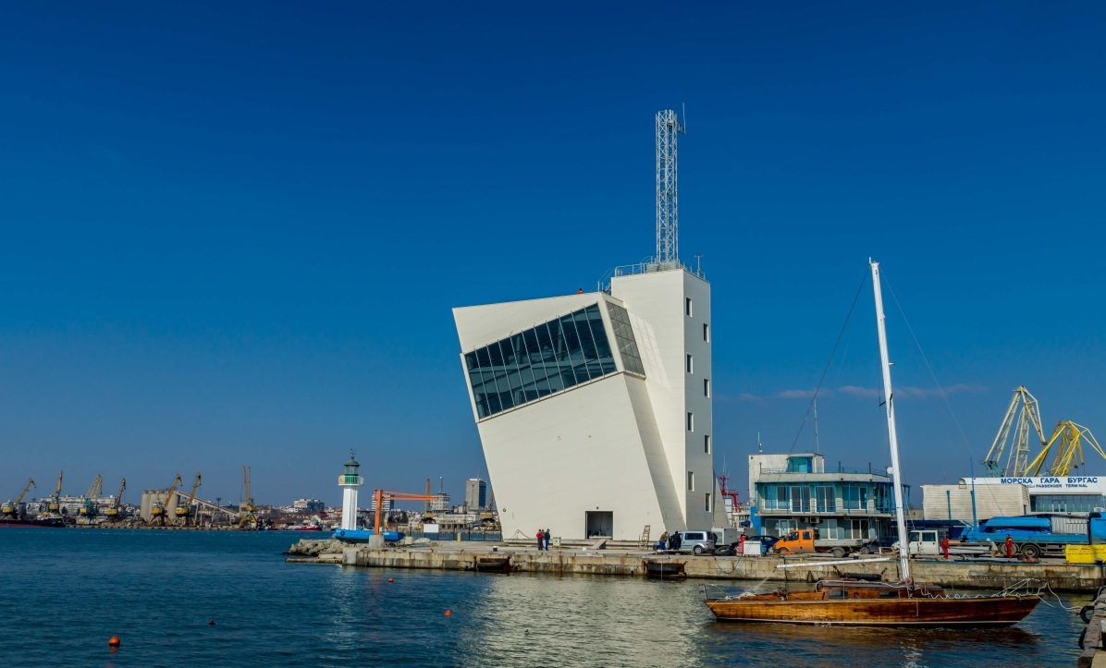
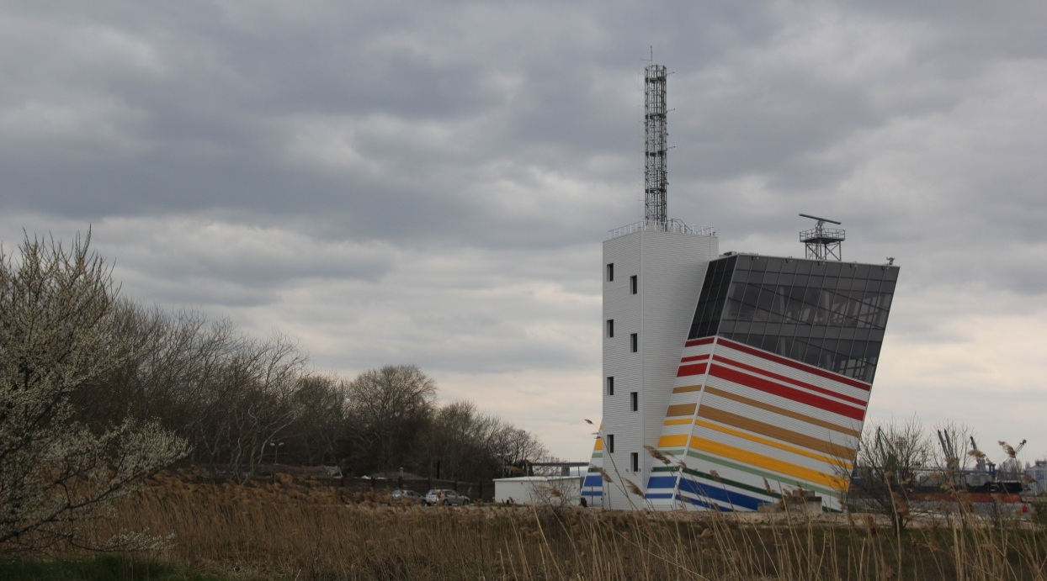
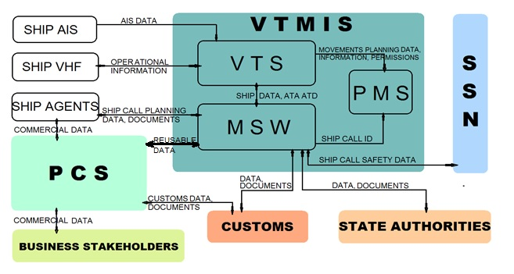
Integrated Information Environment in Bulgarian Ports
BPI Co. has build up one of the most up-to-date vessel traffic management and information system – a base for integrated port electronic information environment
Introduced e-governance in maritime and inland waterway transport – Single Window systems on the sea and river, Port Management System in the sea ports and development of a Port Community System.

Slide 17



Virtual Aids to Navigation
Use of AIS capabilities to broadcast virtual and synthetic AtoN
Visualization of AtoN information for new or temporary objects and dangers to navigation directly on the displays of the ship’s navigation systems (ECDIS);
Significantly improved awareness of the navigational watch.
An example of a practical result of using such a system is the “Mopang” fuel drain operation in the TSS in the approaches of port Burgas:
A vessel sank on 30.06.1921 and started leaking fuel oil in the summer of 2018 in an area of heavy ship traffic.
After broadcasting the virtual and synthetic AtoN the navigation situation has improved significantly.

Slide 18




Artificial intelligence in navigation
Next VTS Generation
Berth-to-Berth Traffic Control
Long Range Monitoring
E-Navigation approach
Active decision support
Modern technologies
(i.e. machine learning, big data analytics)
STC SAFETY MODULE
Track Predictor
COLREG Warning
Active Decision Support
STC Operator approval
Delivery of recommendation to Vessel

Slide 19
Result of the safety, environmental and electronic governance policy of BPI Co.
Improved safety of navigation and improved protection of human life at sea;
Improved environmental protection;
Improved b2g dialogue for enhanced law enforcement and improved safety and security of the ports;
Improved efficiency and competitiveness of Bulgarian ports.

Slide 20




Slide 21




Slide 22




Slide 23

THANK YOU!

