Slide 1


VESSEL TRAFFIC MANAGEMENT, MONITORING AND INFORMATION SYSTEMS FOR BLACK SEA
BULGARIAN PORTS
INFRASTRUCTURE COMPANY
Milen Todorov
Head of Traffic Management – Varna Dept.
Bulgarian Ports Infrastructure Company
Sofia 19.04.2018

Slide 2

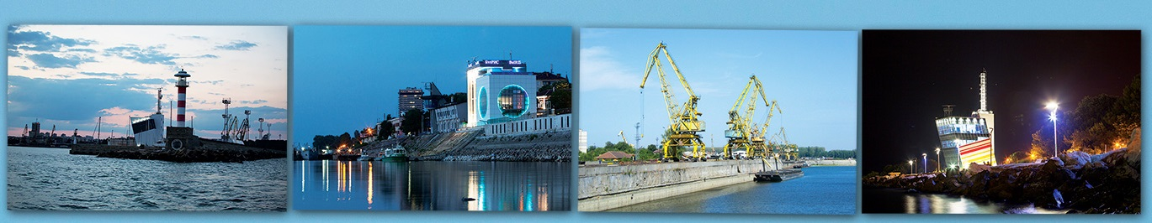
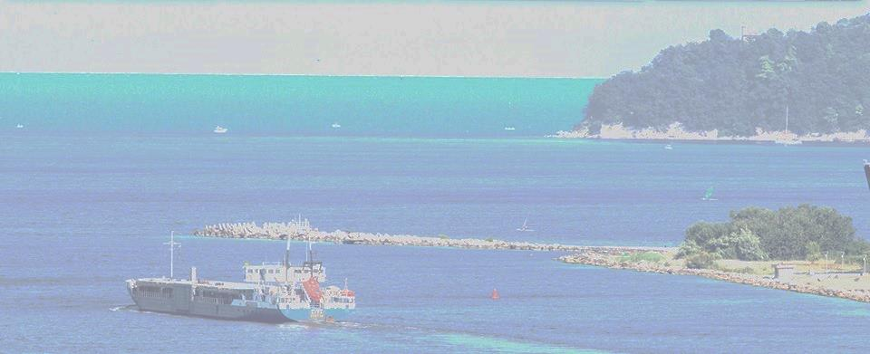
BULGARIAN PORTS
INFRASTRUCTURE COMPANY
THE COMPANY
Bulgarian Ports Infrastructure Company (BPI Co.) manages the port infrastructure of the public transport ports of national importance and provides traffic management and shipping information services.
Object of activity and status of BPI Co. are regulated by the Law on Maritime Spaces, Inland Waterways and Ports of the Republic of Bulgaria.
BPI Co. has four territorial and three specialized divisions in Burgas, Varna, Lom and Ruse.
Notes:
Bulgarian Ports Infrastructure Company is a state company of the Ministry of Transport, Information Tecnology and Communications which manages the infrastructure of the public transport ports of national importance
Among the basic activities of the company regarding these ports are
construction, rehabilitation and reconstruction;
Maintenance of the existing and building of new access channels, port water areas, sea and river depots for dumping of dredging mass, piers, protective installations, etc;
Organization of the ports’ activity and management of their property;
Securing the access to the ports;
Realization of ships’ navigation.
Collecting on Tariff and expanding of :
- channel taxes;
- tonnage ship taxes;
- linear quay taxes;
- light taxes;
- taxes for refuse management – result of shipping activity.
Signing of contracts with port operators for performing of services in the refuse management, resulting from the shipping activity;
Signing of contracts for performing of attending services;
Maintenance and keeping of a register, containing port infrastructure data;
Assisting the Minister of Transport, Information Technology and Communications in monitoring of the concession contracts implementation and the contracts with sole-trader companies for performing of port services and attending activities;
Organization of the collection, maintenance in up to date condition and the conceding of specialized data for the objects from the cadastre and the property register. Preparation of specialized maps, registers and information systems.
Preparation of a project for National Program for Development of Ports and its presentation to the Minister of Transport, Information Technology and Communications;
Work on the actualization and implementation of the National Program for Development of Ports;
Accepting of annual investment programs for ports’ construction, reconstruction, rehabilitation and maintenance and their proposing for approving by the Minister of Transport.
Bulgarian Ports Infrastructure Company is a legal entity on the sense of Article 62, Paragraph 3 of the Trade Law and it has been established according to the Article 115 l of the Law on Sea Spaces, Inland Waterways and Ports of the Republic of Bulgaria.

Slide 3



BULGARIAN PORTS
INFRASTRUCTURE COMPANY
Danube River
PORTS COVERED
Vidin
Oryahovo
Silistra
Somovit
Ruse
Lom
Svishtov
Balchik
Varna
Black Sea
Sofia
Nesebar
Burgas
Notes:
3
Burgas Territorial Directorate spreads its authority from the geographical parallel of the Bulgarian-Turkish boarder line to the geographical parallel of Emine Cape
Varna Territorial Directorate spreads its authority from the geographical parallel of Emine Cape to the geographical parallel of the Bulgarian-Romanian border
Lom Territorial Directorate spreads its authority from kilometer 645 to kilometer 845,650 of the Bulgarian section of the Danube River
Ruse Territorial Directorate spreads its authority from kilometer 374,100 to kilometer 645 of the Bulgarian section of the Danube River

Slide 4
BULGARIAN PORTS
INFRASTRUCTURE COMPANY
THE MAIN PROJECTS IN THE AREA:
Development of Vessel Traffic Management Information System – VTMIS;
Development of River Information System – RIS;
Development and providing electronic data exchange environment for the governmental bodies and business stakeholders in the area of maritime transport:
Developing and providing Maritime Single Windows (MSW) for B2G vessel’s electronic documentation;
Developing and providing a Port Management System;
Developing a Port Community system for B2G and B2B electronic data exchange.

Slide 5
BULGARIAN PORTS
INFRASTRUCTURE COMPANY
JOINT PROJECTS IN THE AREA OF DATA EXCHANGE
INBULMARS – with Maritime Administration;
Monitoring and Information System for Black Sea (BalkanWatch) with Norwegian Coastal Administration;
COPERNICUS – with Nikola Vaptsarov Naval Academy.
Under the “Monitoring and Information System for Black Sea” project BPI Co. cooperates with Nikola Vaptsarov Naval Academy, providing data for validation of IMDatE satellite information:
AIS data
Navigational target data
Navigational radar picture
Navigational history

Slide 6
BULGARIAN PORTS
INFRASTRUCTURE COMPANY
PARTNERSHIP WITH NIKOLA VAPTSAROV
NAVAL ACADEMY IN OTHER AREA:
Education of maritime personnel with programs including subjects, focused on VTS training, and VTS operative service organization;
Postgraduate qualification of VTS personnel under IALA Recommendation and V.103/1-4 Model courses;
Maintaining the qualification of VTS personnel;
Scientific research projects in the area of vessel traffic management and organization of navigation, such as the undergoing:
  "Exploration of the possibilities for increasing the effectiveness and safety of maneuvers, risk assessment and reduction of the unplanned stay of ships in Bulgarian seaports“ project.

Slide 7
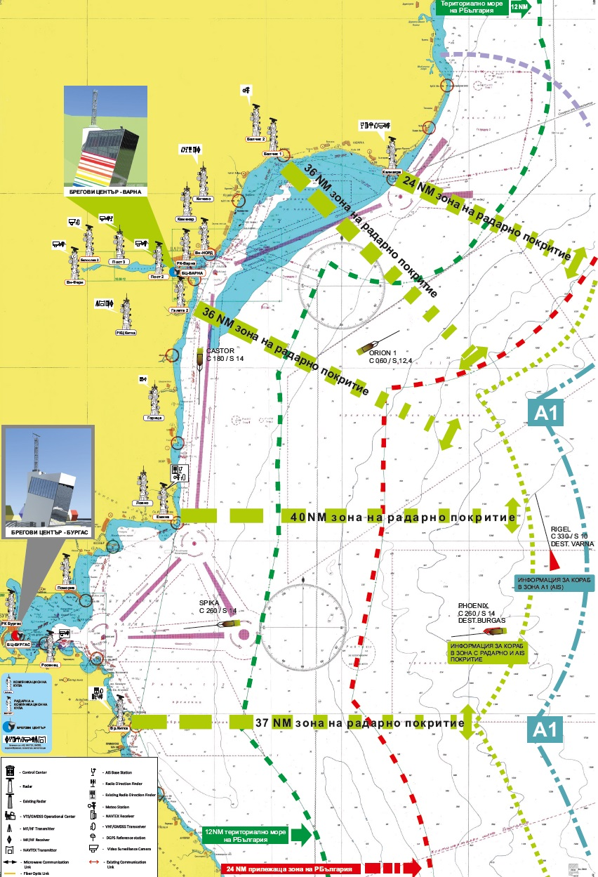
BULGARIAN PORTS
INFRASTRUCTURE COMPANY
VTMIS – ACTUAL SITUATION:
AN INTEGRATED SYSTEM
WITH IMPROVED
CAPABILITIES FOR:
Vessel traffic monitoring and organization;
Ship to shore communication and information services;
Electronic processment of ship documents;
Automatic processment of safety and environmental data to European structures.

Slide 8
BULGARIAN PORTS
INFRASTRUCTURE COMPANY
MAIN SERVICES PROVIDED BY THE VTMIS
Monitoring of vessel traffic for coordination of the actions of ships,
Management of ship traffic in the designated areas,
Enhanced monitoring of vessels which pose a danger to navigation, the protection of human life at sea and the environment,
Collecting, storing and providing information (navigational, meteorological, legal etc.)
Dissemination of maritime safety information,
Provision of communication between ship and shore services,
Provision of data exchange with European systems for maritime safety and security.

Slide 9
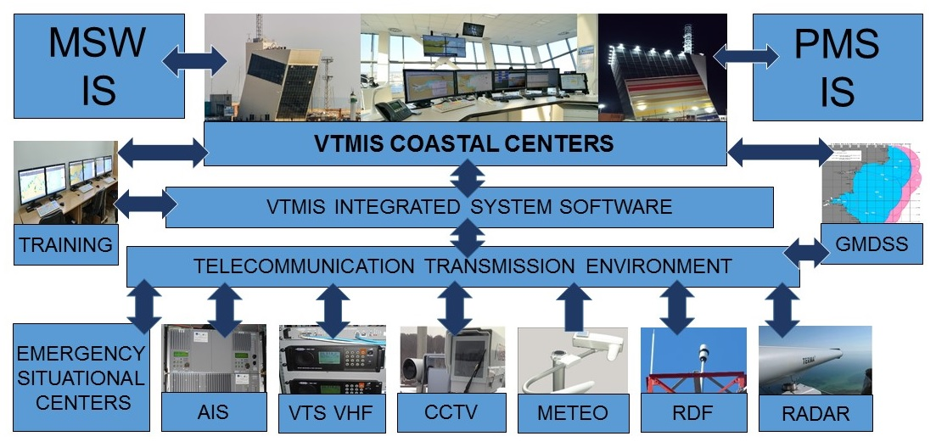
BULGARIAN PORTS
INFRASTRUCTURE COMPANY
STRUCTURE OF THE VTMIS

Slide 10
BULGARIAN PORTS
INFRASTRUCTURE COMPANY
DEVELOPMENT OF MSW IN BULGARIA –
ACTUAL SITUATION
According to the regulations of European Directive 2010/65EU MSW serves as a "single point of contact" for information sharing. Individual data elements should only be submitted once. Data transmission in the MSW can be performed directly by businesses, government agencies or trusted third parties (eg. ship agents) by user interface.
MSW Bulgaria consists of two port office with operator workstations respectively in Burgas and Varna
Both port offices carry out administrative services for information and have redundant functions relative to one another.
International data exchange according to Directive 2010/65/EU is being carried out.

Slide 11
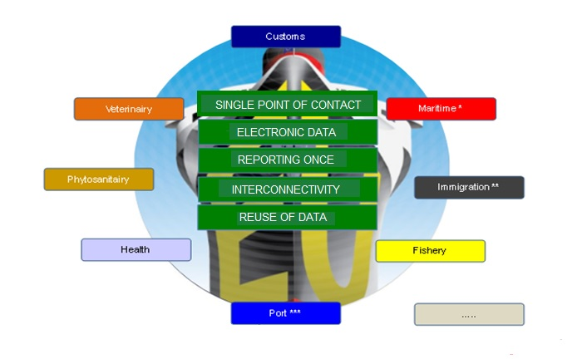
MSW - PRINCIPALS AND PARTICIPANTS
BULGARIAN PORTS
INFRASTRUCTURE COMPANY

Slide 12
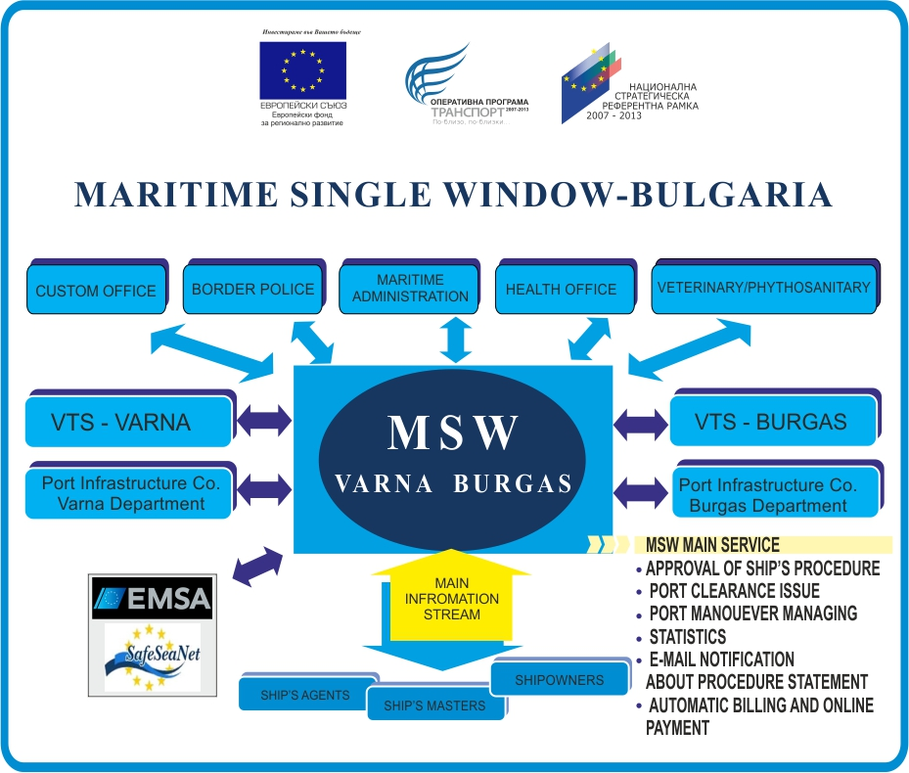
BULGARIAN PORTS
INFRASTRUCTURE COMPANY
MSW BULGARIA - STRUCTURE:

Slide 13
BULGARIAN PORTS
INFRASTRUCTURE COMPANY
PORT MANAGEMENT SYSTEM (PMS) IN
BULGARIAN PORTS – ACTUAL SITUATION
The electronic data exchange environment for port movements planning, called “MOVER” has the purpose to provide an information environment for all participants in the process of planning and performance of vessels maneuvers and a database for following reports. The system represents a module of the MSW and provides a reuse of the main volume of necessary data. It was put into operation on November 25, 2015.
MOVER Functionalities
Vessel port movement management
Generating reports on port movements, terminals status, administrative permissions etc.
Provision /reuse of data for MSW, SSN and other information systems

Slide 14
BULGARIAN PORTS
INFRASTRUCTURE COMPANY
PMS INFORMATION EXCHANGED
Information on planned date of movement and required place in port;
Information on status of readiness of port terminals;
Information on disposition of tugs, pilot boats and other support craft;
Information on availability of pilots and mooring men;
Information on necessary number of tugs and meteorological limitation for every particular vessel and port area;
Times of berthing/unberthing for port taxes calculation;
ATA, ATD, remarks on ship condition, Administration special permissions and comments, accident reporting etc. for SSN and other governmental users – integration via National MSW.
Data for planning and information systems of port terminals, pilot stations, tug companies etc.

Slide 15
BULGARIAN PORTS
INFRASTRUCTURE COMPANY
STRUCTURE OF THE PMS IN BULGARIAN PORTS
Vessel
NSW
Ship Agent
Port terminal
MOVER
Governmental Bodies
Tug Company
Pilot Station
Shore Seamen
VTS
OTHER SYSTEMS
NSW
SSN

Slide 16
BULGARIAN PORTS
INFRASTRUCTURE COMPANY
DEVELOPMENT OF PORT COMMUNITY SYSTEM FOR
B2G AND B2B INFORMATION EXCHANGE
An undergoing feasibility study project aims the development and deploying of electronic data exchange environment for the port community
Since in Bulgaria there was no initiative of the business community in the field of port activities to create PCS and;
Such systems represent a practice-proven solution for great improvement of the effectiveness of ports through intelligent methods:
BPI Co. has committed in developing and provision of such an information environment for the purposes of maritime business environment.
The company recognized the need for far-reaching studies to make the future system an useful facilitating tool for improving the efficiency of Bulgarian ports.

Slide 17
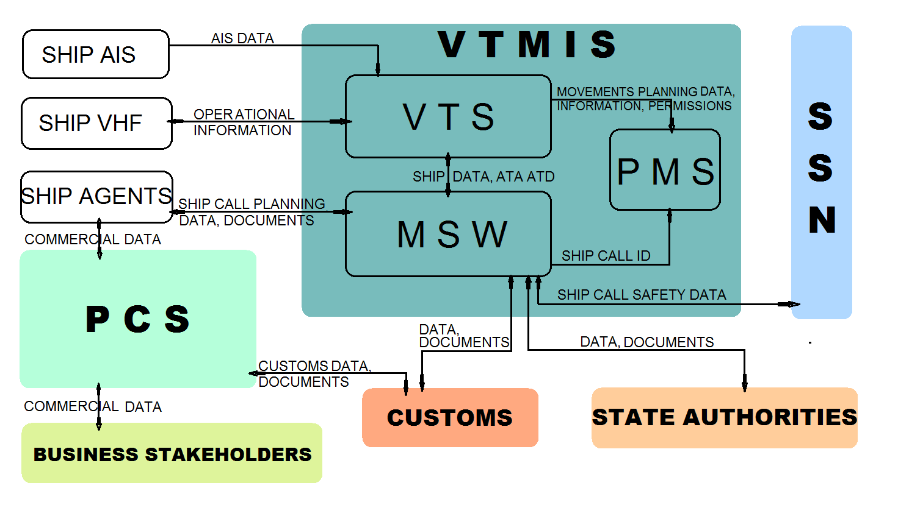
BULGARIAN PORTS
INFRASTRUCTURE COMPANY
STRUCTURE OF THE AUTOMATIC INFORMATION
FLOW IN BULGARIAN PORTS

Slide 18
EXPECTED RESULTS OF THE SAFETY, ENVIRONMENTAL AND ELECTRONIC GOVERNANCE POLITICS OF BPI Co.
BULGARIAN PORTS
INFRASTRUCTURE COMPANY
Improved safety of navigation and improved protection of human life at sea
Improved environmental protection;
Improved b2g dialogue for enhanced law enforcement and improved safety and security of the ports;
Improved efficiency and improved competitiveness of Bulgarian ports.

Slide 19
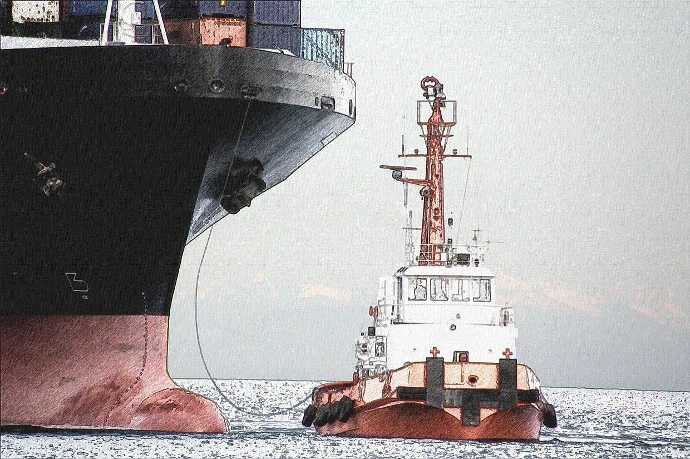
THANK YOU FOR YOUR ATTENTION!

